Slide 1
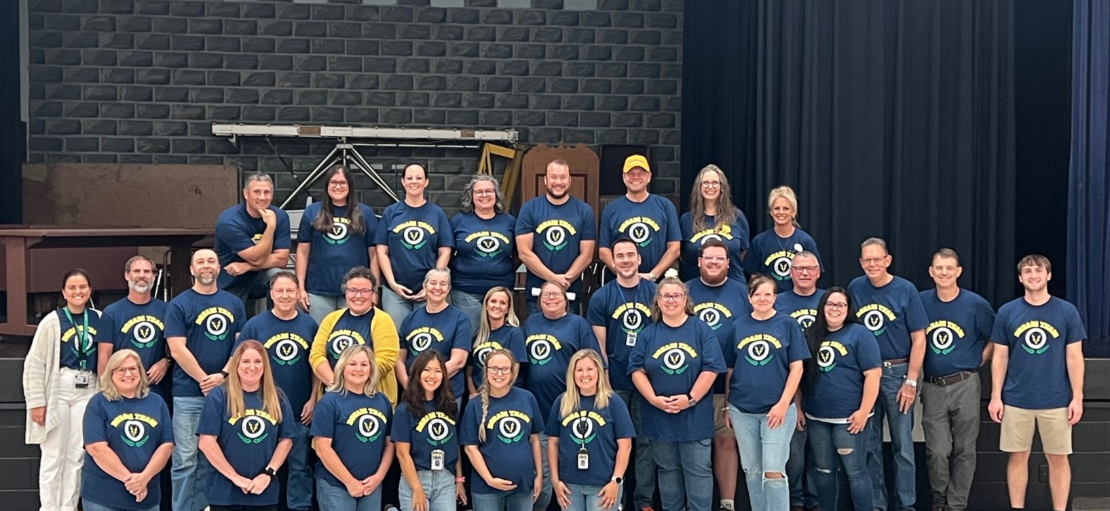
Welcome
Class of 2029!
Go Bluestreaks!

Slide 2
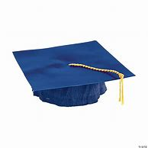
Graduation Requirements
Subject | Required Credits
English | 4
Mathematics | 4
Social Studies | 3
Science | 3*
Physical Education/Health | 1
Sr. Seminar/Fin. Lit. | 1
Vocational/ Practical or Fine Arts (VPF) | 1
World Language-Spanish Electives | 2* 5*
Total: | 24
24 Credits
8 semesters of
attendance
EDP-Xello

Slide 3
Educational Development Plan (EDP)
Graduation Requirement
Begins in 7th grade
Xello
College & Career Readiness Software that Inspires Students | Xello
Xello Login/Password
Ida Email/Password

Slide 4
9th Grade Required Classes
English 1 or Honors English 1
Math(Algebra/Algebra 1A/ Geometry/ Honors Geometry)
Biology or Honors Biology
World History
PE & Health
Spanish 1
Elective
**Honors Course Enrollment
Student Request
90% grade average for the 3 quarters
NWEA Benchmark testing: rank in the top 32 scores get in to the class
Teacher recommendation: rubber stamp approval

Slide 5
High School Schedule
9th Grade:
English I
Algebra 1A/Algebra I/Geometry
Biology
World History
PE/Health
Spanish I
Elective/VPF/CTE
11th Grade:
English 3
Geometry/Algebra II/Pre-Calculus
Physics*
Economics/Government
Electives/VPF
Dual Enrollment/Ida Early Middle College
2-4 College Classes = 6-12 credits
10th Grade:
English 2
Algebra 1B/Geometry/Algebra II
Chemistry
American History
Spanish 2*
Elective/VPF/CTE
12th Grade:
English 4
Senior Seminar/Financial Lit
Algebra 2C/PreCalculus/Calculus
Electives
Dual Enrollment/ Ida Early Middle College
2-6 College Classes = 6-18 credits

Slide 6
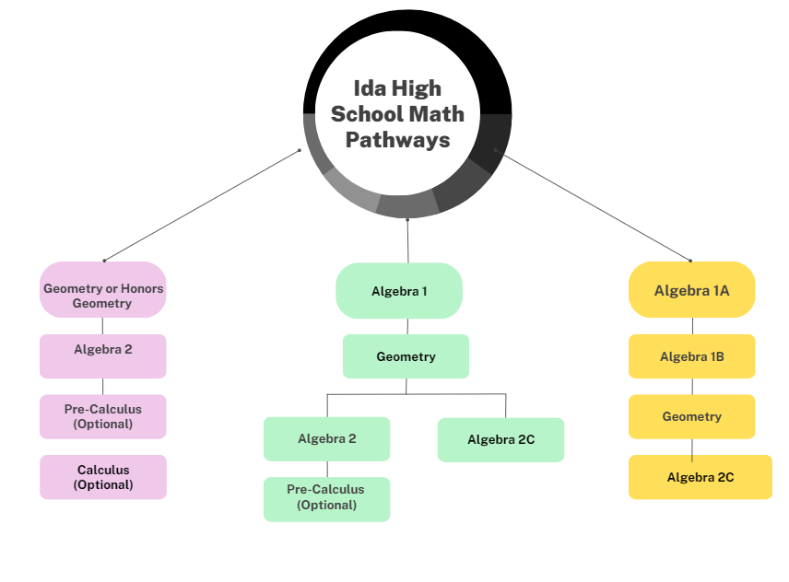
Math Pathways
Michigan Requirements:
Algebra 1/Geometry/Algebra 2/Senior Sen & Fin Lit

Slide 7
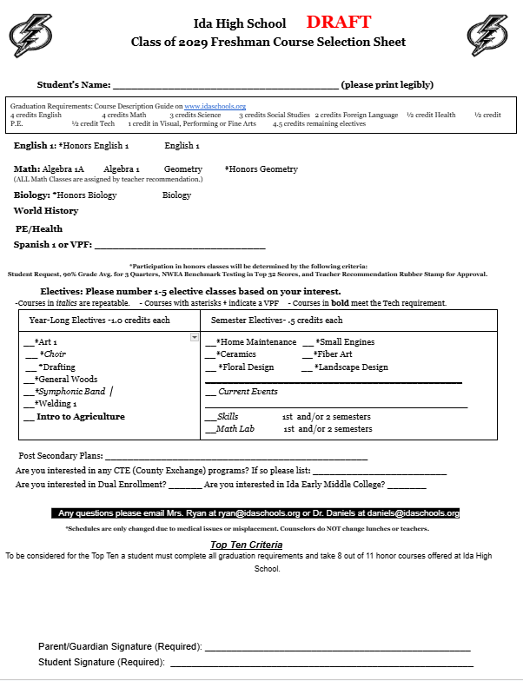
8th Grade Presentation & Individual Scheduling Meetings
will take place March 17th & 18th!

Slide 8
9th Grade Electives
Semester courses .5 Year long courses 1
- Symphonic Band (VPF)
- Small Engines (VPF) - Wind Ensemble* (VPF)
- Home Maintenance (VPF) - Choir (VPF)
- Fiber Art (VPF) - Art 1 (VPF)
- Ceramics (VPF) - General Woods (VPF)
- Math Lab - Drafting (VPF)
- Skills - Welding (VPF/CTE)
- Current Events -Intro to Agriculture (CTE)
- Floral Design (VPF)
- Landscape Design (VPF)
*Teacher recommendation required for this section

Slide 9
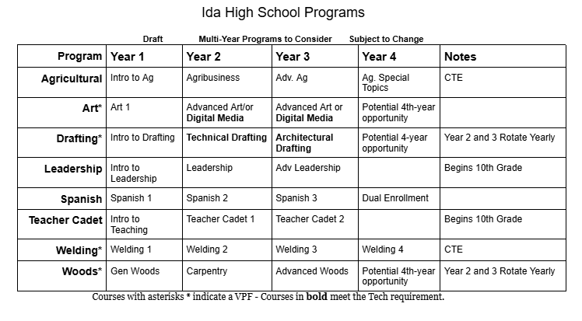

Slide 10
Top Ten Criteria
Complete all graduation requirements
Must take 8 out of 11 honors courses
-Honors English 1, 2, 3, 4
-Honors Geometry, Pre-Calculus, Calculus
-Honors Biology, Honors Chemistry,
Physics 2, Anatomy and Physiology

Slide 11
All course descriptions
are available at
the Ida HS Guidance Department Webpage
Course Guide
Any high school student who wishes to test-out of a course in which s/he is not enrolled may do so by taking the final examination for the course and receiving a grade of at least 78% or by demonstrating mastery of the subject matter as determined by the assessment used in lieu of a final examination. Credit for a course earned by a student through this process may be used to fulfill a course or course-sequence requirement and be counted toward the required number of credits needed for graduation but may not be used to determine the student’s GPA. Requests must be made by May 1st.

Slide 12
Dual Enrollment
Students can dual enroll their Junior and Senior year of High School.
Students must meet college directed & Ida High School academic standards.
Students must have their own transportation.
Motivated and high achieving students may earn up to 30 credits at MCCC.
There may be financial costs for failed courses/books/supplies.
Academic and social maturity is paramount for success as a dual enrollment student.
Mandatory Parent Night in Spring of Sophomore year.

Slide 13
Ida Public Schools
Accelerated Career Planning and Preparation
Ida Early Middle College (IEMC)

Slide 14
IEMC: How It Works
Ida Early Middle College gives students the opportunity to earn an extra year of college credits.
Similar to Dual Enrollment Junior and Senior year. All core classes are completed at Ida.
Student participates with current class in all aspects of their senior year. However, they do not get their diploma or officially graduate until the completion of their 5th year.
IEMC students are eligible for Top Ten with their original graduating cohort.

Slide 15
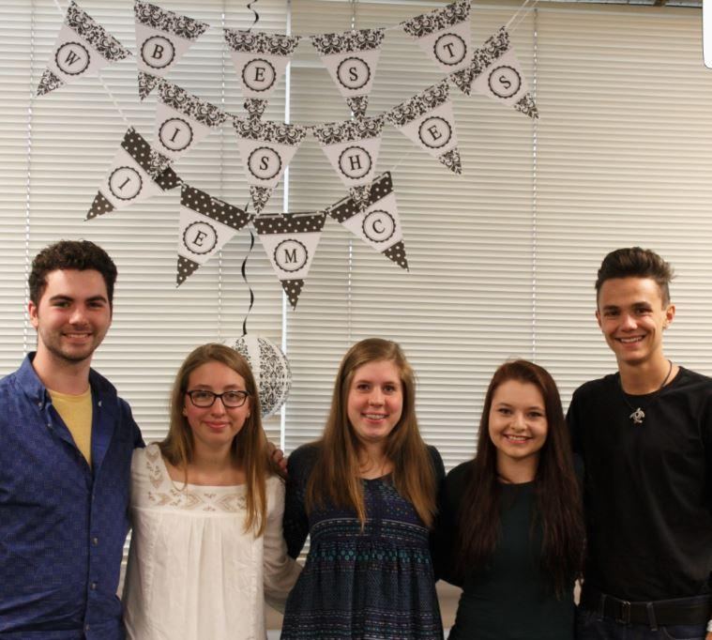
IEMC: Cont.
Students can participate in High school programs and sports through their 4th year.
Students can wait until the 4th or 5th year to take college classes.
Applications are submitted by end of Sophomore year.
Students must meet certain academic standards and have personal transportation to the college.

Slide 16
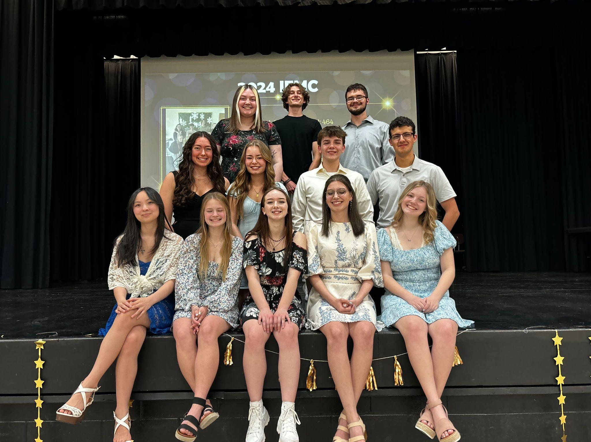
IEMC Graduating Classes
2017-2024
Total Number of Students: 70
Total Credits Earned: 2,563
39 Transferred & 22 Cont at MCCC
6 Associate’s Degrees
6 Certifications
Money Saved over: $427,287
Scholarships offered over: $428,540
MEMCA IEMC
-Average Credits Earned 49.5 47
-Average GPA 2.93 3.17

Slide 17
County CTE Exchange
Access to CTE Programs that IHS does not offer
Typically 2 hour block
Transportation
Typically 11th-12th grade students
*Electrical Tech program housed at MCCC
*EMT/Firefighter program at Dundee High School
*Health Occupations at Monroe High School
*Cosmetology at Michigan College of Beauty
*Criminal Justice Program at ISD
*Precision Machining Technology housed at MCCC

Slide 18
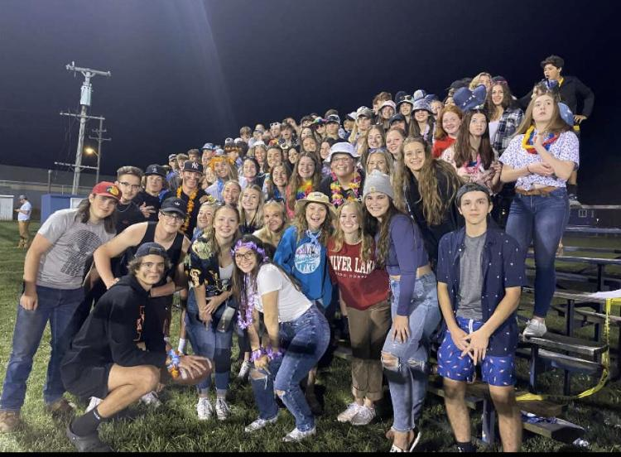
Preparing for High School
Get to know the Team
Get involved
Think about your future goals
Academic Career
GPA
High School Credits
Attendance

Slide 19
Any Questions?
Mrs. Caitlin Ryan ryan@idaschools.org
Dr. Randy Daniels daniels@idaschools.org
https://www.idaschools.org/schools/high-school/guidance-department/

