Slide 1

Ida Early Middle College
& Dual Enrollment
Ida High School
April 9, 2025
Mrs. Ryan
Dr. Daniels

Slide 2

WHAT IS DUAL ENROLLMENT & IDA EARLY MIDDLE COLLEGE (IEMC)?
Dual Enrollment and Ida Early Middle College allows college-ready students in high school, who qualify for college admission to earn college credit prior to graduation.

Slide 3
DUAL ENROLLMENT & IDA EARLY MIDDLE COLLEGE IS NOT . . .
Dual Enrollment/Ida Early Middle College is not a replacement for high school.
First and foremost you are a high school student and a teenager. Your educational choices should reflect your personal ability, college, and career goals.
Ida High School offers a quality education and students are encouraged to take advantage of everything Ida has to offer.

Slide 4

GRADUATION REQUIREMENTS
Students participating in the dual enrollment and Ida Early Middle College program must still meet ALL state and district requirements for graduation.
Dual enrollment courses count as elective high school credit.
Students may take a maximum of 10 dual enrollment courses.
Students may not take more than 6 dual enrollment courses in any academic year.
Grades from college classes may impact both the high school and college GPA.

Slide 5

DUAL ENROLLMENT COURSES
Students may take courses available at Monroe County Community College that are not offered at IHS, apply toward a degree or professional certificate, and meet general requirements at MCCC.

Slide 6

PLANNING AHEAD
Students should begin planning what they will do after they graduate from IHS or IEMC
Many students will work toward a degree or program at MCCC or take classes that they plan to transfer to another college or university.
COURSE PLANS at MCCC: https://www.monroeccc.edu/pathways
MCCC Transfer info https://www.monroeccc.edu/transfer
Research which courses transfer https://www.transferology.com/chooseyourpath.htm
Michigan Transfer Network https://www.mitransfer.org/
Michigan Transfer Agreement https://www.monroeccc.edu/transfer/michigan-transfer-agreement

Slide 7
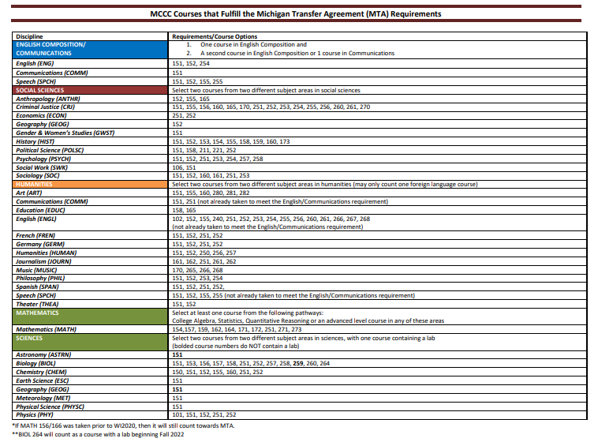
MCCC Michigan Transfer Agreement Courses
+

Slide 8
MCCC Update for Fall 2025
Traditional Classes-in person classes usually meeting twice a week
Online classes-all work is done online
Other options, please review MCCC for further information:
https://www.monroeccc.edu/online-and-hybrid-courses
Please consider the following:
  Highly recommend taking in person classes but there are some exceptions
  Student’s academic skills
  Student’s responsibility and maturity

Slide 9

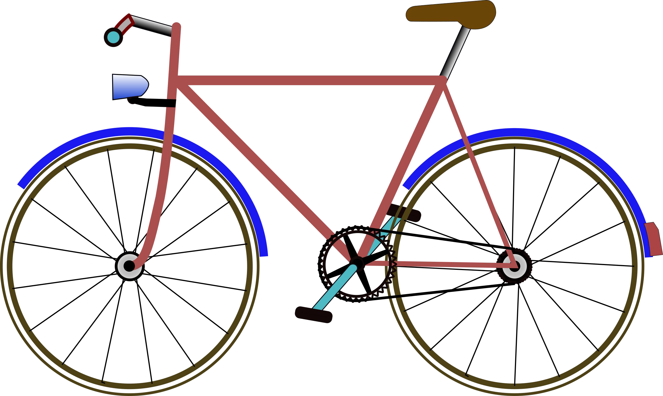
ADDITIONAL COLLEGE EXPENSES
Course Materials (Textbooks & Online Codes)
Some college textbooks are available to borrow in the Ida High School library.
Textbooks may be reimbursed by Ida High School if the State amount has not been exhausted. Students will need to hand in their textbook and original receipt with the textbook request form. Forms are due two weeks after the MCCC semester ends.
Reimbursement amounts will be calculated by taking the amount of money received from State Aid and subtracting tuition and fee costs for each course.
Transportation
Ida High School is not responsible for providing transportation of students. Students must be able to transport themselves to and from the community college in order to participate in dual enrollment/IEMC.
Notes:
Mention different types of textbooks (traditional/ebooks/loose leaf) Buy New or Used or Rent (Many in our library)
Online codes-if possible we will reimburse for all forms including online cores
Check comes well after the semester

Slide 10

SCHOOL CALENDAR
Dual enrollment courses will follow the MCCC calendar as far as start/end dates for their semester and breaks (i.e. Spring Break).
The high school schedule always takes precedence over that of the community college. If a student’s attendance is required at the high school, they are expected to make arrangements with their college instructors (i.e. semester exam schedules).
Students may not sign up for dual enrollment courses whose meeting time that would require them to be late or to leave early from a high school class.
School cancellations or delays do not apply to college courses taken on the college campus. Students will still be expected to go to class unless the College also cancels. They too have an automated system to sign up for in case of cancellations.

Slide 11
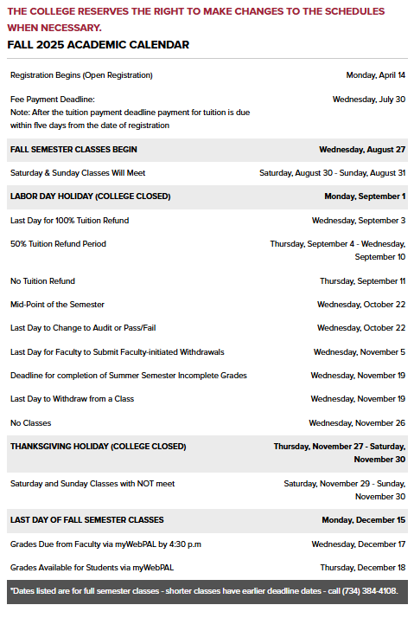
Notes:
Not updated for Fall, but student will receive one
Withdrawal and Drop Datel

Slide 12

STUDENT SUPPORT SERVICES
As a dual enrollment/IEMC participant, students are considered to be college students and thus have access to all the services and supports afforded to all full-time enrolled students at the community college.
Services may include …
Academic Tutoring (Study Skills, Writing & Math Labs)
Campus Libraries
Computer Labs
Career Services
Counseling Services
Transfer Coordinators
Athletic/Fitness Facilities
Students must use their community college instructors and support services.
Tutoring/Learning Assistance | Monroe County Community College (monroeccc.edu)

Slide 13
FAILURE OR NON-COMPLETION OF COURSES
Students who fail or do not complete a dual enrollment course (i.e. drop the course after the drop deadline established by the community college) will be held financially responsible for the full cost of the course.
These costs must be settled with the district in order for a student to participate in graduation ceremonies and/or receive their diploma.
Students who fail courses may also jeopardize their continued participation in the dual enrollment program.
Failing dual enrollment courses may negatively impact a student’s standing at their post-secondary schools after graduation.

Slide 14
College Class Eligibility
Student must be on track for high school graduation
Students must have met the following criteria:
  Must have a 2.5 GPA
  B or better in the list two semester of HS English
  C or better in both semesters of Algebra 1
    If one of these is not met, students must take the Accuplacer on 4/22.
Must apply to MCCC
Must meet all Ida High School requirements and deadlines to participate
Notes:
2.5 GPA a few exceptions Automotive, welding, ect
Accuplacer-Lunch meeting today to review their scores (if they need to retake than they can do so at the college testing center)

Slide 15
IS DUAL ENROLLMENT/IDA EARLY MIDDLE COLLEGE RIGHT FOR ME?
Things to Consider
Future plans
Study Habits
Reading & Writing Abilities
Time Management Skills
Ability to Ask Questions & Seek Help
Social/Emotional Maturity
Ability to Work with Different People
Involvement Level in High School (Extracurricular Activities)
Notes:
Average age of MCCC Student is 23
Time Management -Credit college class 2 hour of studying outside of class. One 3 credit class Mon/Wed 8:00-9:20 6 hours a week additionally studying for that class
Social/Emotional Maturity-

Slide 16

Registration Checklist
Consider your future goals and make sure this is a fit.
Make sure your student meets previously mentioned academic requirements.
Apply to MCCC by April 9th!
Complete Google Interest Form by April 9th
Monday, April 14th Student Lunch Meeting
  During this meeting: review offered courses, checklist, orientation, books, etc.
Review and Complete the Fall Dual Enrollment Registration form with parents.
Turn in signed Registration Form to IHS office ASAP. All forms must be submitted by May 1st.
  Counselor will review form, approve with signature, and submit the form and HS transcript to MCCC.
If applicable, complete IEMC Application and turn into IHS office by May 16th .

Slide 17
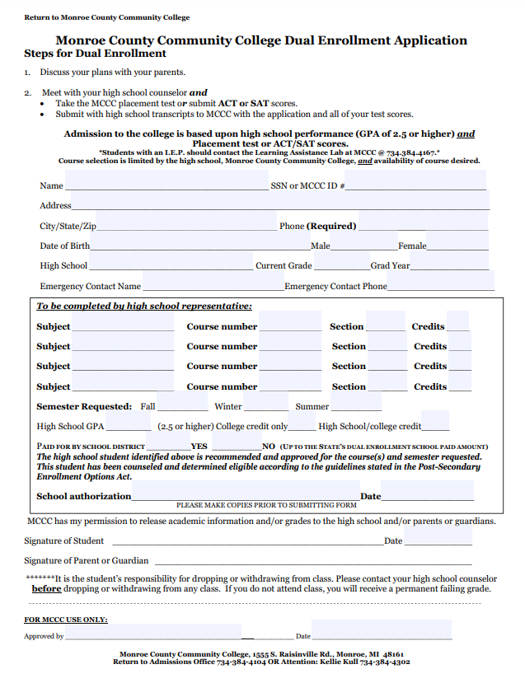
Dual Enrollment forms must be turned into the Ida High School office by May 1st.
First week of school:
Mandatory Fall Meeting for all
Dual Enrollment and Ida Early Middle College Students
Notes:
talk about gpa on both transcripts?

Slide 18

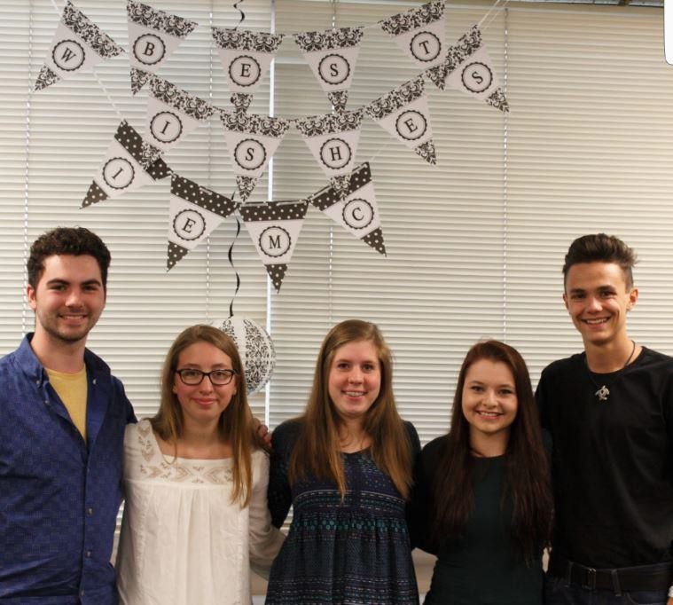
HIGH
IDA
SCHOOL
PRESENTS...

Slide 19
BASIC INFO
Similar to Dual Enrollment Junior and Senior year.
Ida Early Middle College gives students the opportunity to earn an extra year of college credits (up to 60 credits total).
Student participates with current class in all aspects of their Senior year.
IEMC students participate in graduation with their class, but do not get their diploma or officially graduate until the completion of their 5th year.
Students will be ranked with their class.
Students can participate in high school programs and sports through the 4th year.
Students may wait until the 4th or 5th year to take college classes.
Math course required during the 5th year.

Slide 20

BASIC INFO
At the end of the 5th year the student will have opportunity to earn all of the following:
  High School Diploma
  MEMCA Certificate
  Up to an Associate's degree

Slide 21
IEMC STUDENT SUPPORT AND TRANSFER
Student Support
Students have access to high school and
MCCC support services
Regular contact with high school counselor
3rd-4th year IEMC seminars
5th year mandatory conference with college advisor
IEMC 5th year seminars once a month
Transfer Options
Research transfer college/university
Students are considered 1st year students
Customizable Education Options
Flexibility with MCCC classes
The state requires that students apply for Middle Colleges before the end of the Sophomore year, but they can withdraw from IEMC

Slide 22








APPLICATION PROCESS
Discuss with your family if IEMC is the correct program for you.
If planning to take classes junior year, complete all previously mentioned dual enrollment requirements.
Complete IEMC application and turn it into Mrs. Ryan by May 16th
Participate in IEMC interview in late August/Early September

Slide 23
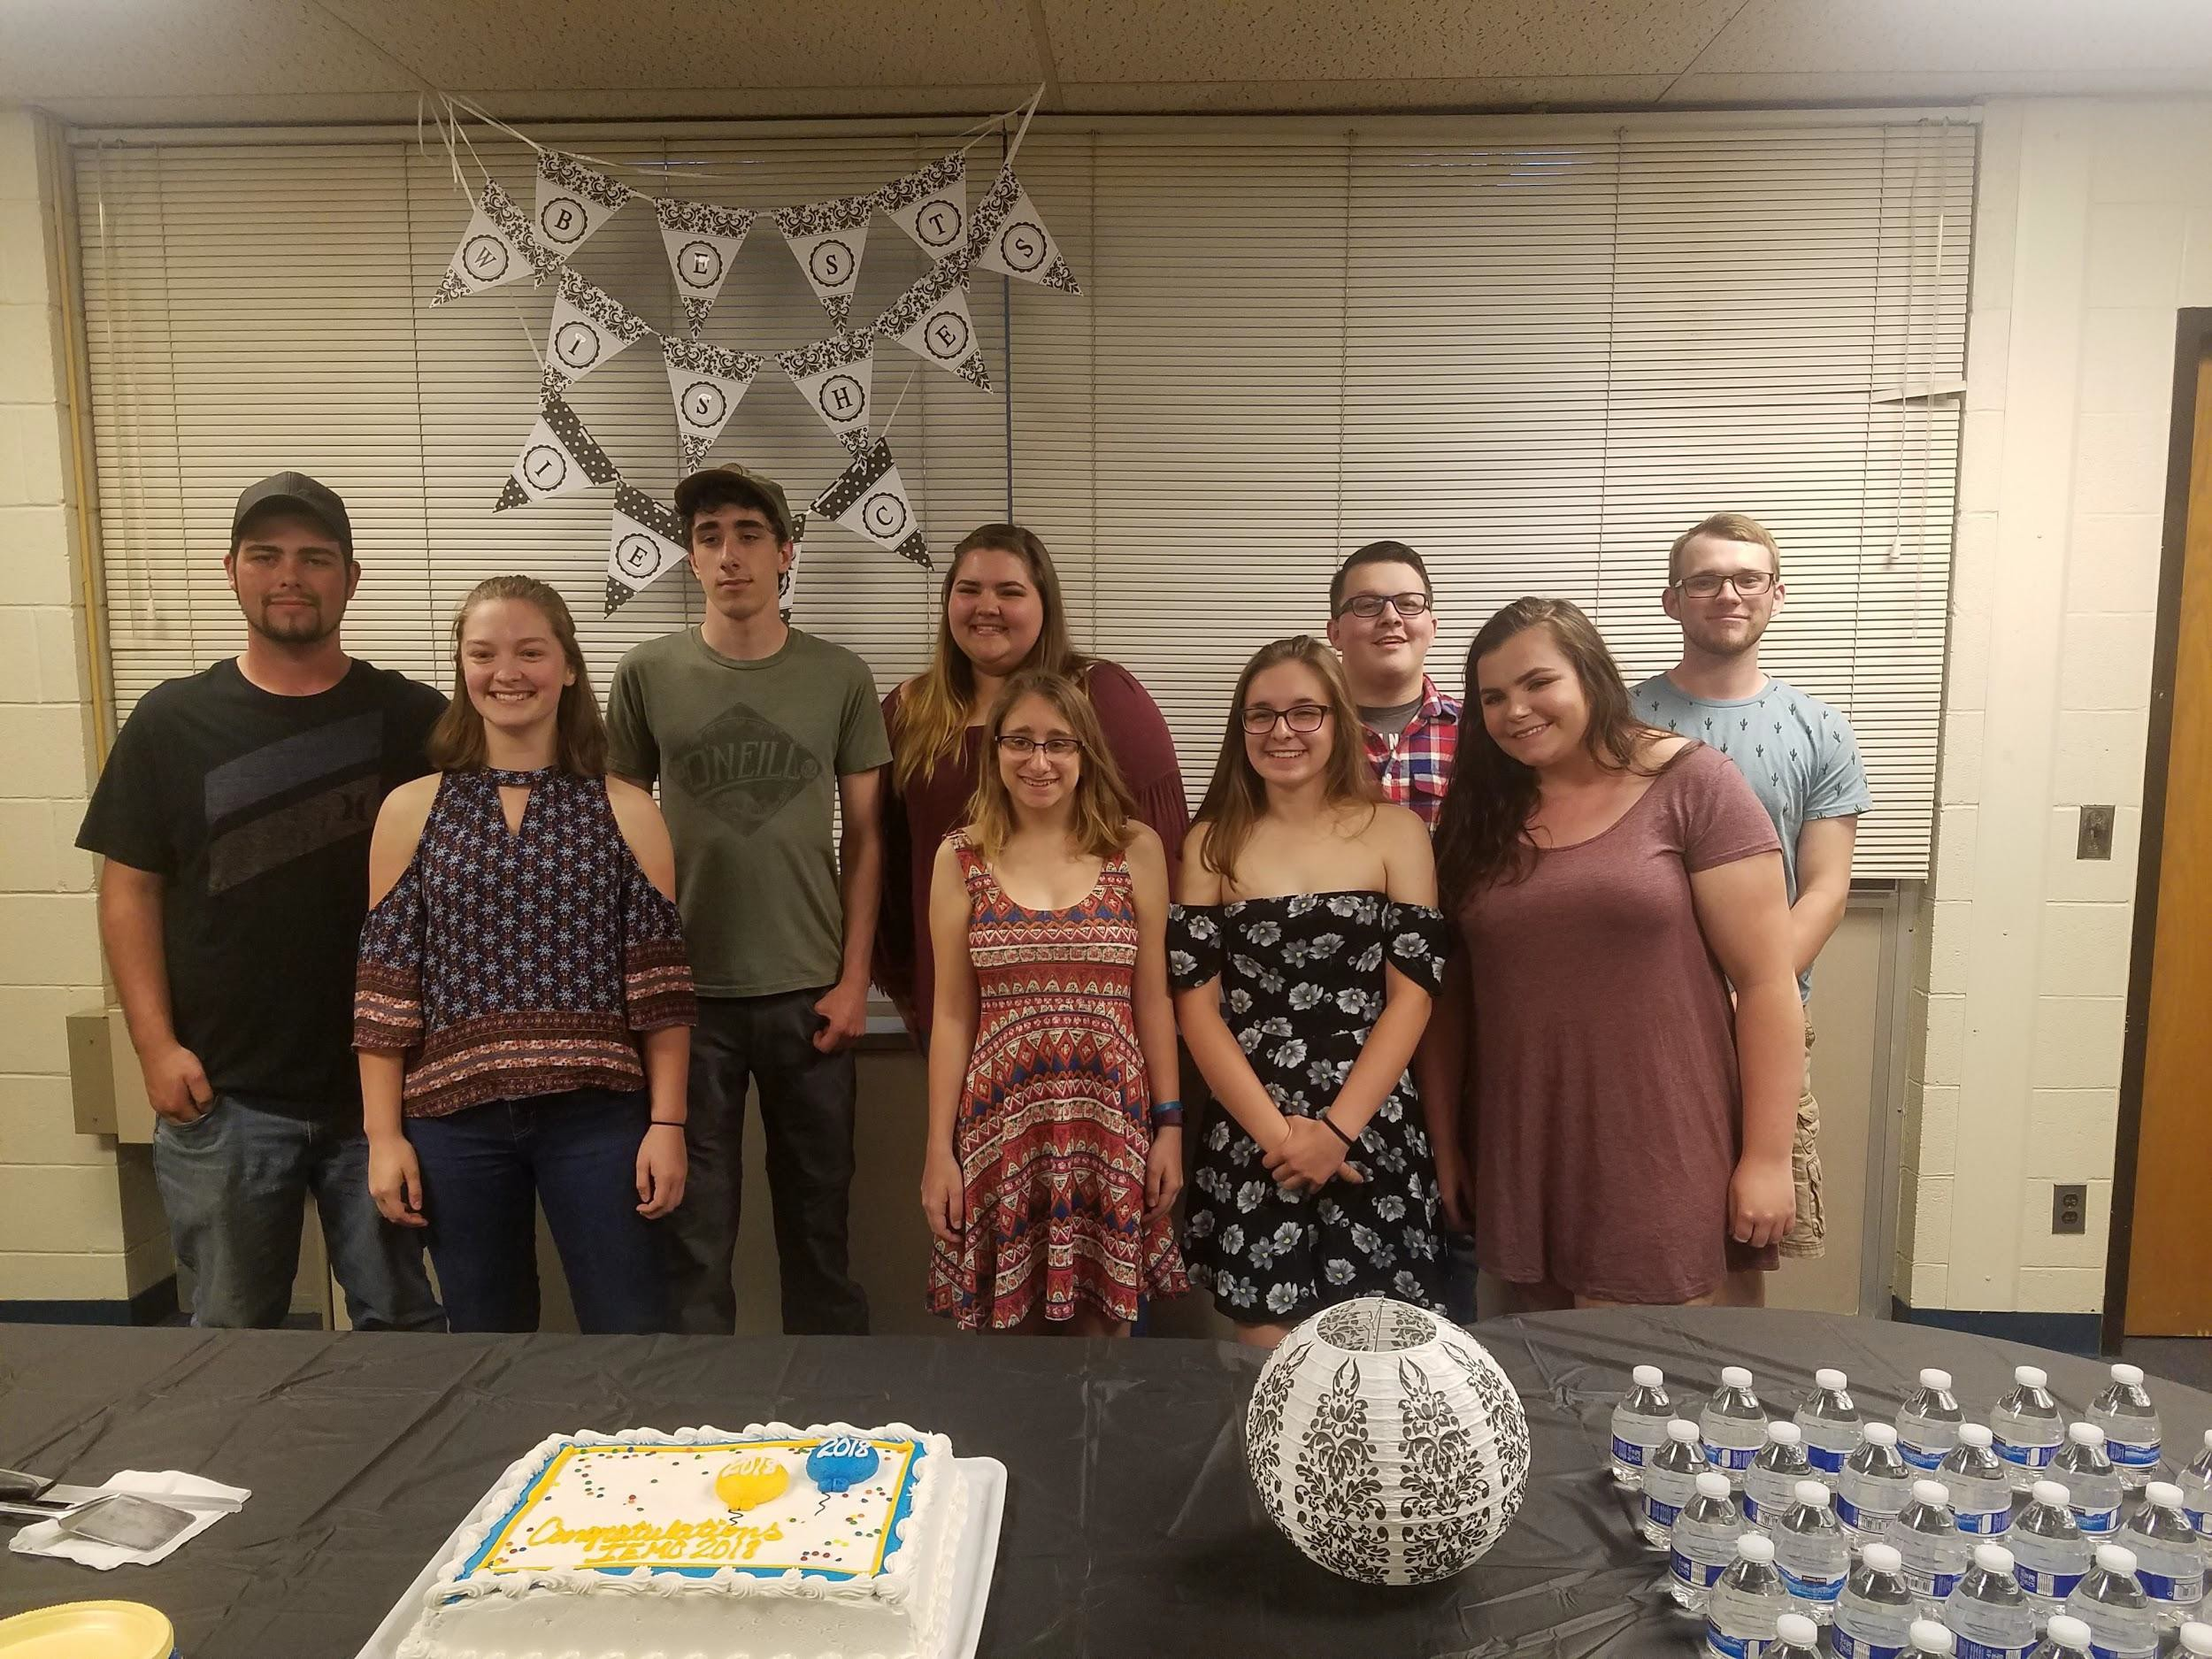
IEMC Graduating Class 2017-2024
Total Number of Students: 70
Total Credits Earned: 2,563
39 Transferred & 22 Cont at MCCC
6 Associate’s Degrees
6 Certifications
Money Saved over: $427,287
Scholarships offered over: $428,540
 | MEMCA | IEMC
-Average Credits Earned | 49.5 | 47
-Average GPA | 2.93 | 3.17

Slide 24
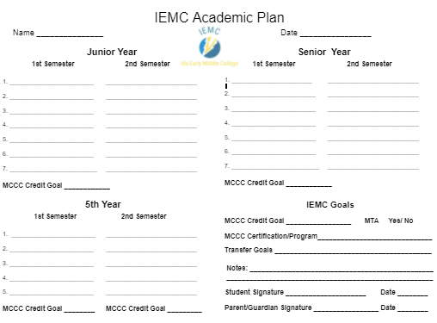
Individual Academic Plan for Each IEMC Student

Slide 25
Student Experience & Advice From IEMC Students
When asked “Do you feel like you achieved your goals through IEMC?”
“For sure, I started the RN program this winter so I’d say I did pretty good”
“Yes, I had no idea what mechanical design engineering was, and fell in love with the program. I also have already had interviews with a local company who I will be starting with after receiving my college degree.”
“IEMC helped me make sure I was choosing classes that were right for me, so I feel like that helped me take on the classes with more confidence knowing that I was actually going to need them for the degree I was pursuing. “
When asked “Are you glad you decided to be apart of the IEMC program? Why or why not?”
“Yes because it gave me a full year of college and kept me from deciding not to go to college, it motivated me.”
“Yes! Got me to push myself & achieve/figure out what I want to do”
“Yes, I was able to get almost 60 credits for free! “
“100% glad I decided to come into this program, it has given me many opportunities that at may have not been possible before”
Yes, I had a huge head start on college and feel proud of what I’ve accomplished.

Slide 26

Questions???
ryan@idaschools.org
daniels@idaschools.org

