Slide 1
Grad. Req.
Emp. Rates
Future Options
Paying for College
College Month
Senior College Month
Class of 2023

Slide 2
…248 days until Graduation!

Slide 3
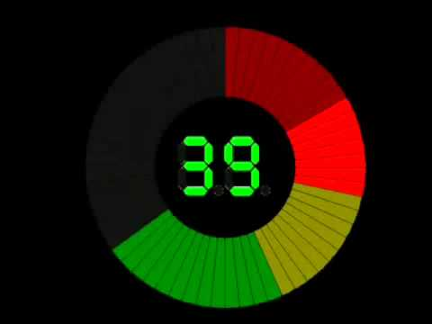
How many credits do you need to graduate?
How do we define college?
What is the difference between a community college and a university?
What is a certificate and where would a student earn one?
What are some other ways an individual could get trained for a career?
Write down two questions you have about transitioning out of high school.
POP QUIZ

Slide 4
Graduation Requirements
English: 4 credits
Social Studies: 3 credits
Mathematics: 4 credits
Science: 3 credits
Physical Education: .5 credit
Health: .5 credit
Computers: .5 credit
Senior Seminar/Financial Literacy: 1 credit
Visual, Performing, and Applied Arts: 1 credit
*World Language: 2 credits
Electives: 4.5 credits
Total: 24 credits
*One World Language credit may be substituted for an additional Visual or Performing Arts credit

Slide 5
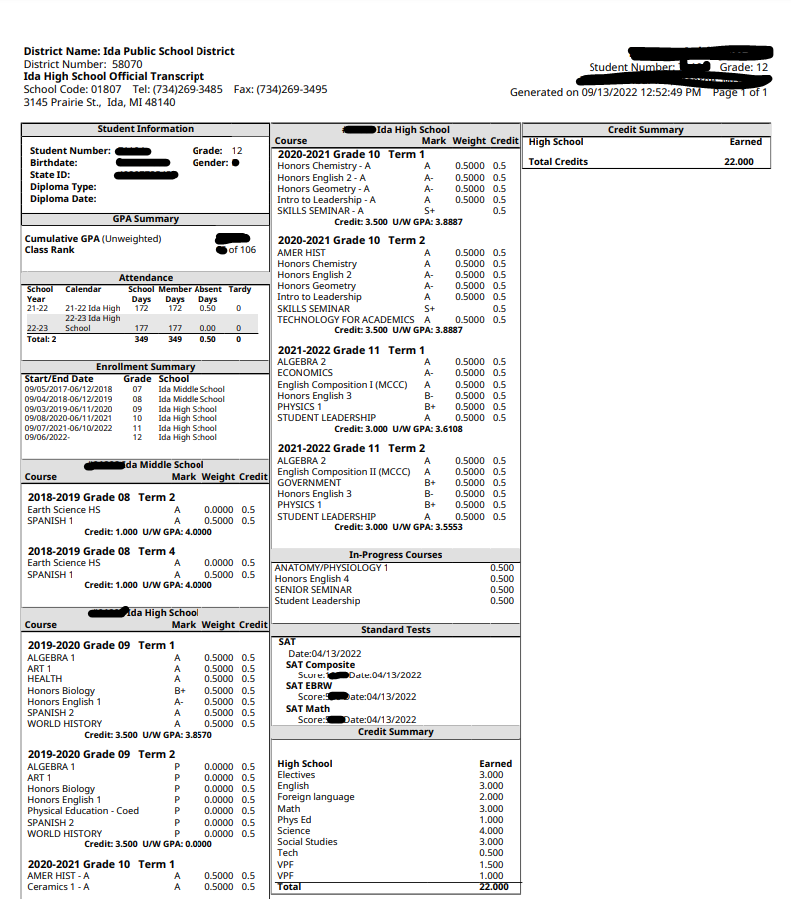
Transcripts

Slide 6
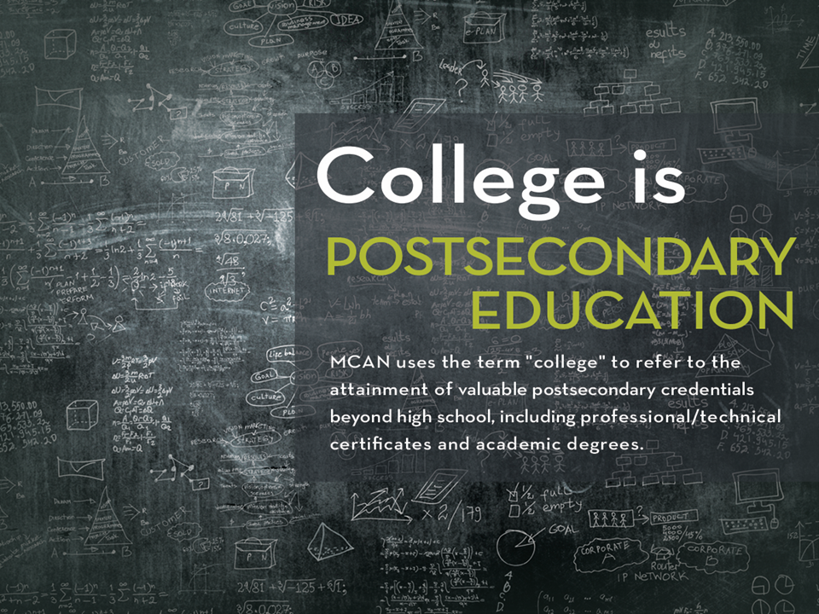
WHY?
Your potential job options increase with a college degree.
32% of jobs in the U.S. require an associate or bachelor’s degree
An additional 14% require a master’s or professional degree.
By earning a degree, you automatically give yourself the opportunity to apply for the 46% of U.S. jobs that now require a secondary degree.

Slide 7
By 2025, 60% of U.S. will need some quality credential beyond high school.
https://luminafoundation.org/stronger-nation/report/#/progress/state/MI&county-highlight=Monroe

Slide 8
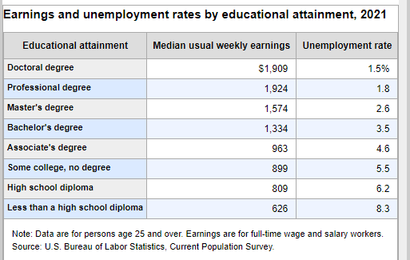

Slide 9
What’s next & How do I get there?

Slide 10
Military
What are some of the benefits of joining the military?
Is the military a good option for you?

Slide 11





If you are interested in the military:
Meet with recruiters from 2 different branches
Take the ASVAB- Nov. 8th 1st-3rd hours @ IHS
Long Term Plan
Start Training
Military Links

Slide 12
Skilled Trades
What would be considered a skilled trade?
High Skill, High Pay, High Demand
Type of trainings
On the Job
College Classes
Apprenticeship/Union

Slide 13
If you are interested in the skilled trades:
Research Possible Careers & Programs
Start Working
Take Advantage of Current Classes
MCCC Apprenticeships
Upcoming Opportunities:
  Just Build It @ EMU Oct. 18th Sign up in the office
  Union Trade Presentations in the winter
  Career Expo in the Spring

Slide 14
College & University
    Senior Year Timeline
        12th Grade Checklist
    Research Colleges Goal 5
        MI Public Universities & MI Institutions
        My Big Future & College Scorecard
      At School-Browse & Reps at Lunch-See schedule outside counselor’s office
      College Visits & Open Houses
        College Night at MCCC??

Slide 15
If you are interested in going to college:
Research Schools
Apply Apply Apply!
  2 dream schools (at or little below)
  2 target schools (within)
  2 safe schools (exceed)
Application Day Oct 20th
2022 IHS Application Info Sheet
Letters of Rec Form for Mrs. Ryan
Common Application Common Application Guide
    Early Decision Nov 1st
Send Transcripts (See Mrs. Nowak)
  Dual Enrollment MCCC Transcript Requests
  SAT Scores SAT Scores
Retake ACT/SAT ACT SAT
Register with NCAA and/or NAIA if applicable NCAA NAIA

Slide 16
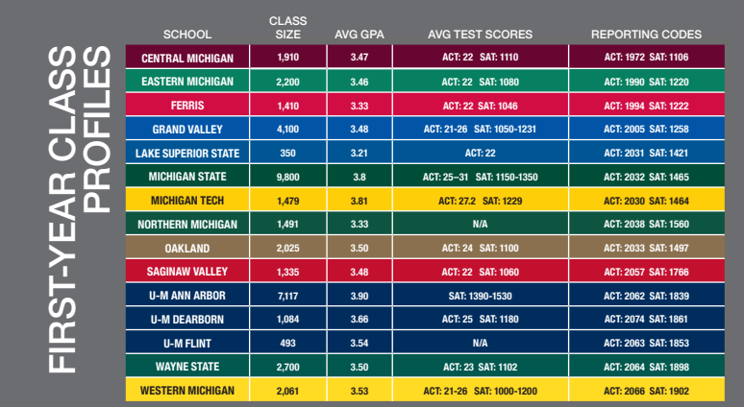
Cambia tu fondo en Zoom
Inicio
Fondos
Avatares
Planificadores
Tarea
Cambia tus fondos fácilmente y haz que tus videollamadas de Zoom sean más divertidas y originales

Slide 17
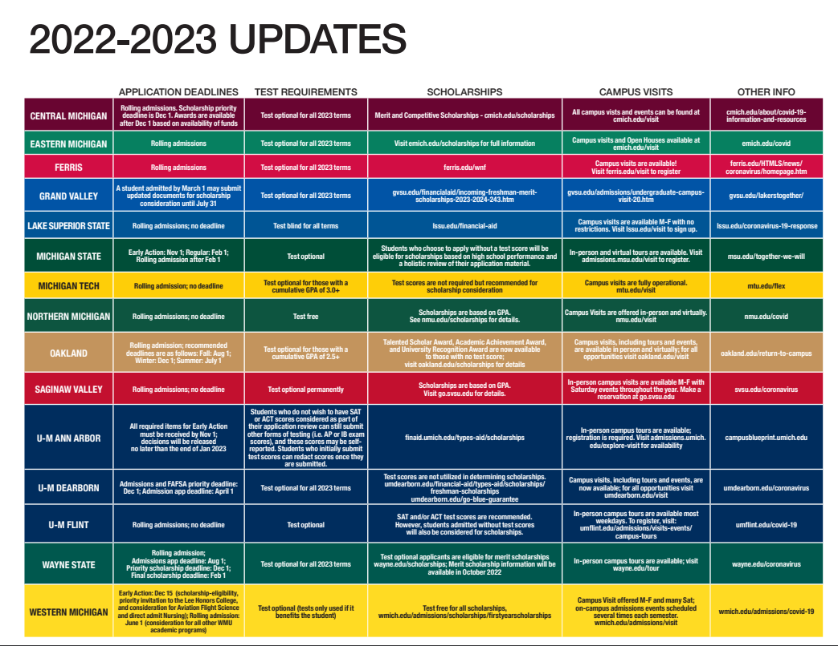

Slide 18
Paying for College
How much does college cost?
What are some ways you can pay for college?
BE A SMART CONSUMER!

Slide 19
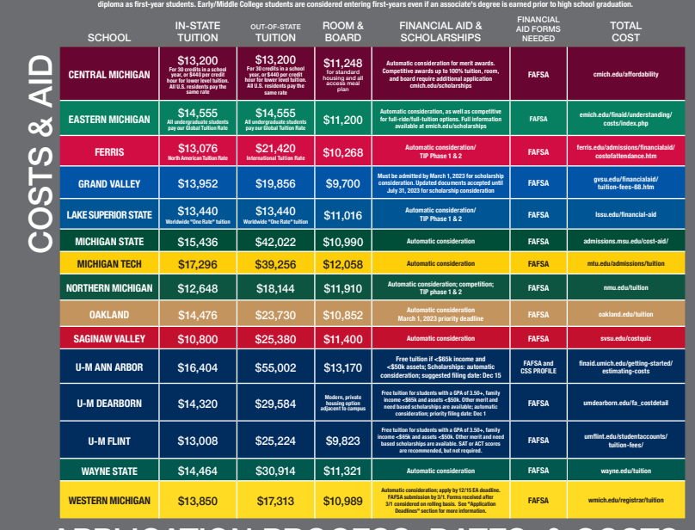
Cómo hacer tu avatar
Inicio
Fondos
Avatares
Planificadores
Tarea
Paso 1
¡Personaliza el avatar para que tenga todos los complementos que quieras!
Paso 2
Paso 3
Por último, puedes cambiar el color de cualquier pieza si lo necesitas
MCCC 4,000
UT 11,885

Slide 20
Types of Scholarships
Community
  Ida Community Scholarships
Company/Organizations
Merit
University/College Scholarships

Slide 21
Scholarship Search Sites
State and Local Search
National Scholarship Search
www.goingmerry.com
mybigfuture.com
www.salliemae.com
www.scholarships.com
www.fastweb.com
www.cappex.com
www.scholarshippoints.com
www.chegg.com
www.unigo.com
www.collegeboard.org
www.niche.com
www.collegexpress.com
www.careeronestop.org
www.studentscholarships.org
scholars.horatioalger.org
www.aws.org
MI Student Aid Pg 12
MI Student Portal
MI Scholarship Search

Slide 22
Merit & Competitive Scholarships
Merit Scholarships -Scholarships offered to students when they apply based on merit (GPA and/or SAT). FAFSA often required
University of Toledo Merit Scholarship
MCCC Merit Scholarship

Slide 23
Paying for College
FAFSA
Scholarships
Loans
Grants
Work Study
PAYING FOR COLLEGE NIGHT
October 27th @ 6 PM
High School Library

Slide 24
College Month
College Month Events & Raffle
College Month Survey

