Slide 1
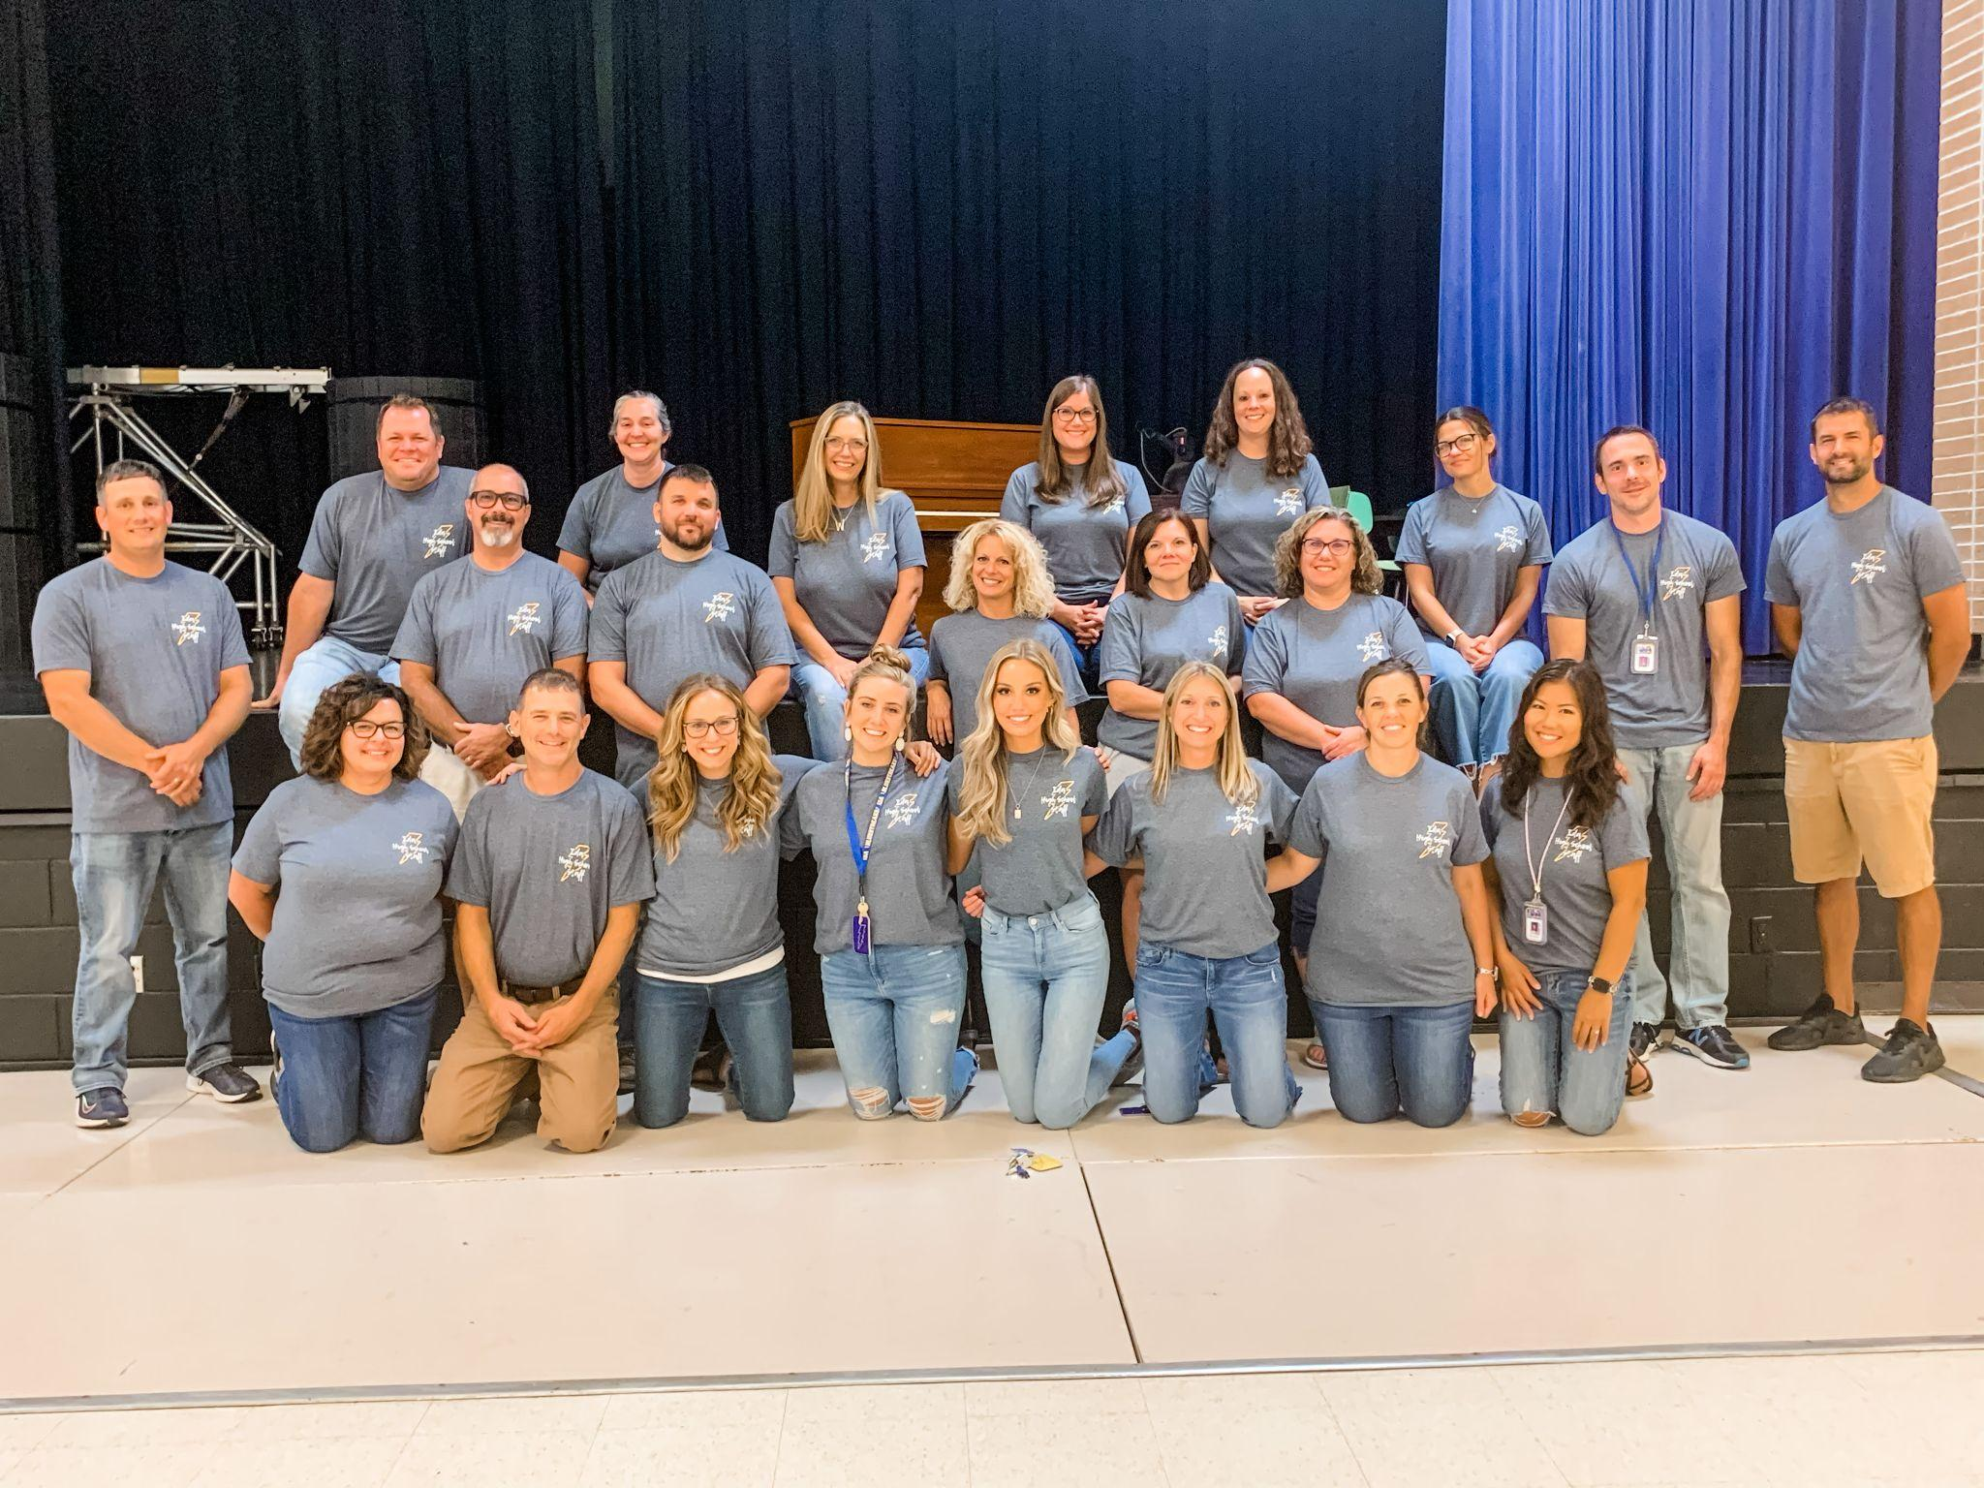
Welcome Class of 2027!
Slideshow

Slide 2
Graduation Requirements
Subject | Required Credits
English | 4
Mathematics | 4
Social Studies | 3
Science | 3
Physical Education/Health | 1
Computers | .5
Sr. Seminar/Fin. Lit. | 1
Vocational/ Practical or Fine Arts | 1
World Language-Spanish Electives | 2 4.5
Total: | 24
24 Credits
8 semesters of
attendance
EDP-Career Cruising

Slide 3
Educational Development Plan (EDP)
Graduation Requirement
Begins in 7th grade
Career Cruising
http://careercruising.com
Login: First Name.Last Name
Password: Ida StudentID

Slide 4
9th Grade Required Classes
English 1 or Honors English 1
Math(Algebra/Algebra 1A/ Geometry/ Honors Geometry)
Biology or Honors Biology
World History
PE & Health*
Spanish 1*
Elective
*Graduation requirement but can be postponed.

Slide 5
High School Studies
9th Grade:
English I
Algebra 1A/Algebra I/Geometry/H Geometry
Biology
World History
PE/Health
Spanish I/Elective
Elective/VPF
11th Grade:
English 3
Geometry/Algebra II/Pre-Calculus
Physics
Economics/Government
Electives
Dual Enrollment/Ida Early Middle College
4 College Classes = 12 credits
10th Grade:
English 2
Algebra 1B/Geometry/ H Geometry/Algebra II
Chemistry
American History
Computers (Yearbook/Tech/Drafting/Test Prep)
Spanish II/VPF
Elective
12th Grade:
English 4
Senior Seminar/Financial Lit
Algebra 2C/Pre-Calculus/Calculus
Electives
Dual Enrollment/ Ida Early Middle College
6 College Classes =18 credits

Slide 6
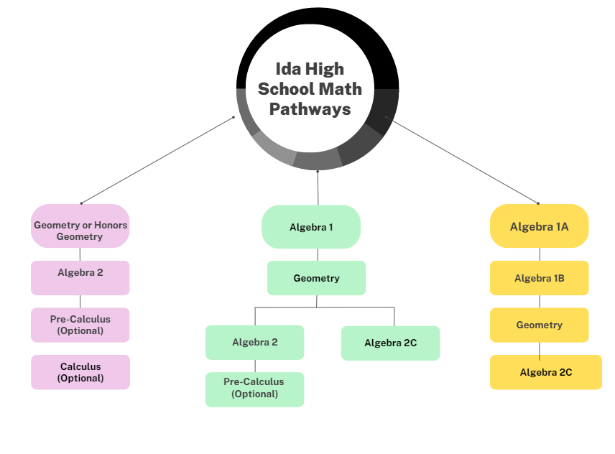
Math Pathway
Michigan Requirements:
Algebra 1/Geometry/Algebra 2/Senior Sen & Fin Lit

Slide 7
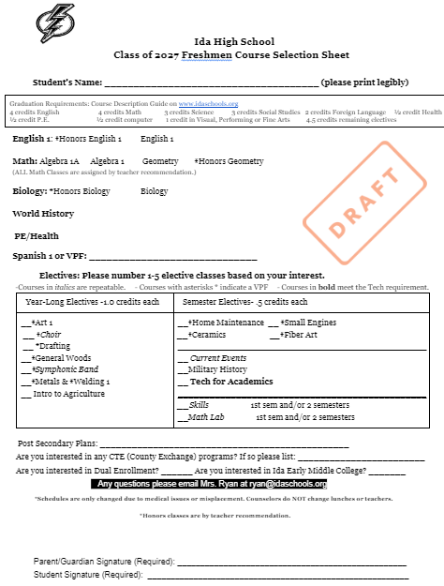
February 2nd during 6th hour
8th Grade Presentation
February 6, 8, 9
Course Selection Sheets due and student scheduling conferences

Slide 8
9th Grade Electives
Semester courses .5 Year long courses 1
- Technology for Academics - Symphonic Band (VPF)
- Small Engines (VPF) - Wind Ensemble* (VPF)
- Home Maintenance (VPF) - Choir (VPF)
- Fiber Art (VPF) - Art 1 (VPF)
- Ceramics (VPF) - General Woods (VPF)
- Math Lab - Drafting (VPF)
- Skills - Metals/Welding (VPF)
- Current Events -Intro to Agriculture
- Military History
*Teacher recommendation required for this section

Slide 9
New Top Ten Criteria
Complete all graduation requirements
Must take 8 out of 11 honors courses
-Honors English 1, 2, 3, 4
-Honors Geometry, Pre-Calculus, Calculus
-Honors Biology, Honors Chemistry,
Physics 2, Anatomy and Physiology

Slide 10
All course descriptions
are available at
the Ida HS Guidance Department Webpage
Course Guide
Any high school student who wishes to test-out of a course in which s/he is not enrolled may do so by taking the final examination for the course and receiving a grade of at least 78% or by demonstrating mastery of the subject matter as determined by the assessment used in lieu of a final examination. Credit for a course earned by a student through this process may be used to fulfill a course or course-sequence requirement and be counted toward the required number of credits needed for graduation but may not be used to determine the student’s GPA. Requests must be made by May 1st.

Slide 11
Dual Enrollment
Students can dual enroll their junior and senior year of high school.
Students must have a 2.5 GPA recommended and qualifying test scores (SAT/Accuplacer)
Students must have their own transportation.
Motivated and high achieving students could earn up to 30 credits at MCCC.
There may be some financial cost for courses taken or if a student fails a class.
Academic and social maturity is paramount for success as dual enrollment student.
Required parent night spring of Sophomore year.

Slide 12
Ida Public Schools
Accelerated Career Planning and Preparation
Ida Early Middle College (IEMC)

Slide 13
IEMC: How It Works
Ida Early Middle College gives students the opportunity to earn an extra year of college credits (60 credits total).
Similar to Dual Enrollment junior and senior year. All core classes are completed at Ida.
Student participates with current class in all aspects of their senior year. However, they do not get their diploma or officially graduate until the completion of their 5th year.
IEMC students are eligible for Top Ten with their original graduating cohort.

Slide 14
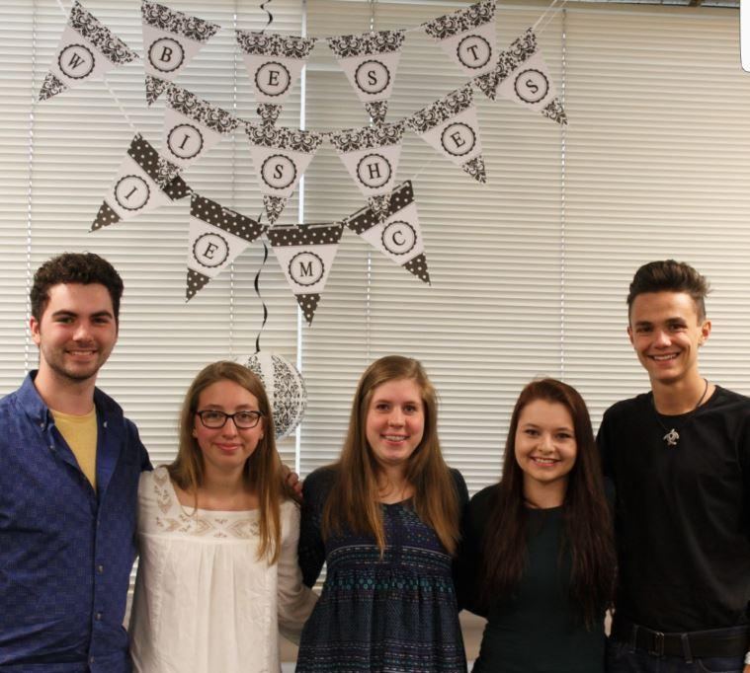
IEMC: How It Works
Students can participate in high school programs and sports through their 4th year.
Students can wait until the 4th or 5th year to take college classes.
Applications are submitted by end of Sophomore year.
Students must meet certain academic standards and have personal transportation to the college.

Slide 15
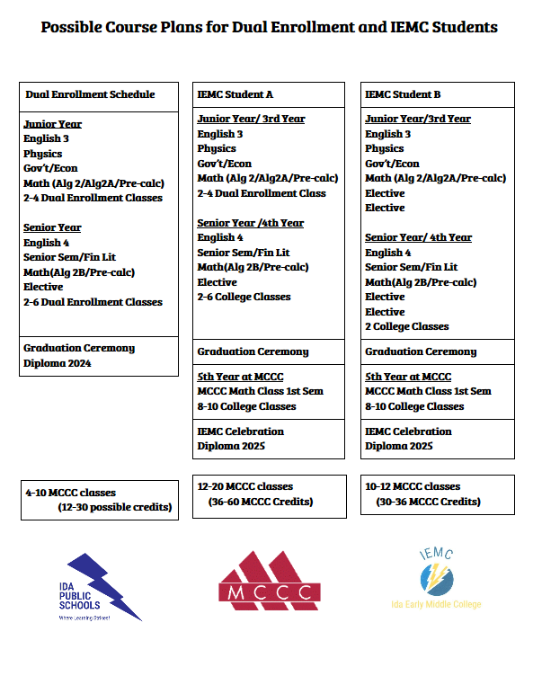

Slide 16
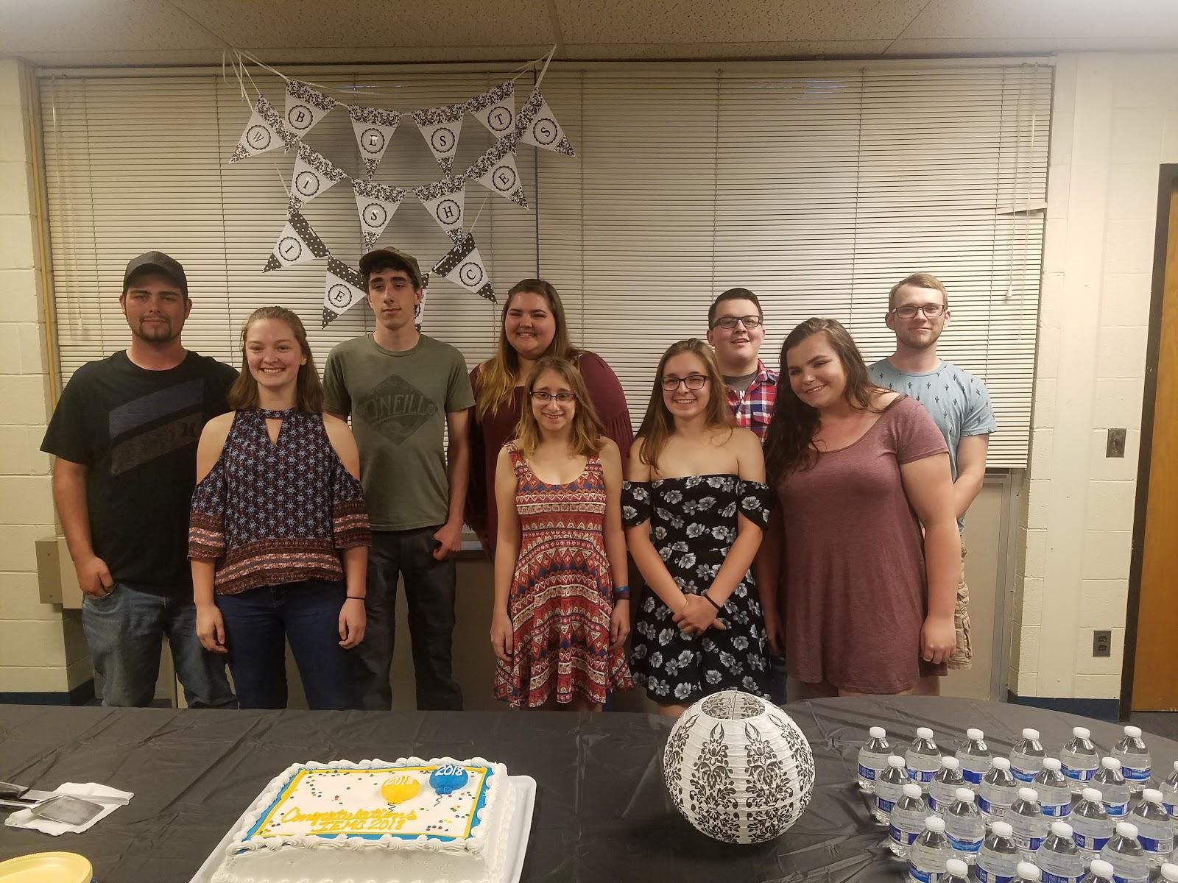
IEMC Graduating Classes
2017-2022
Total Number of Students: 46
Total Credits Earned: 2,026
21 Transferred & 14 Cont at MCCC
6 Associate’s Degrees
6 Certifications
Money Saved over: $273,000
Scholarships offered over: $221,000
MEMCA IEMC
-Average Credits Earned 49.5 45
-Average GPA 2.93 3.06

Slide 17
County CTE Exchange
Access to CTE Programs that IHS does not offer
Typically 2 hour block
Transportation
Typically 11th-12th grade students
*Electrical Tech program housed at MCCC
*EMT/Firefighter program at Dundee High School
*Health Occupations at Monroe High School
*Cosmetology at Michigan College of Beauty

Slide 18
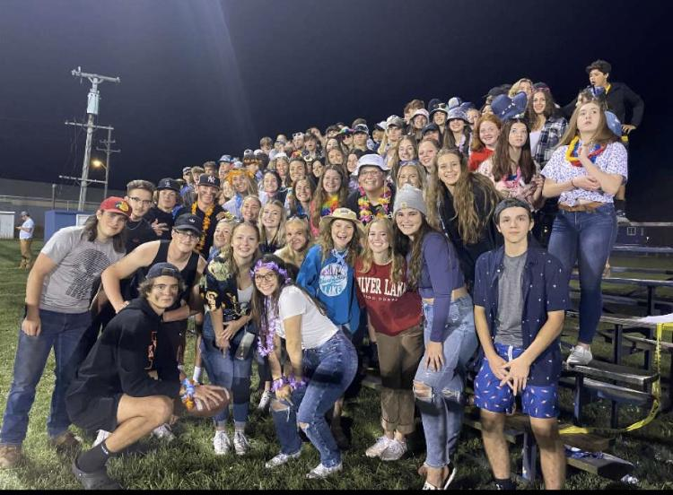
Preparing for High School
Get to know the staff
Get involved!
Prepare for your future goals
Academic Career
GPA
High School Credits
Attendance

Slide 19
Any Questions?
Thank you for coming
Kelly Riley
Riley@idaschools.org
Caitlin Ryan Ryan@idaschools.org
https://www.idaschools.org/schools/high-school/guidance-department/

Slide 20
ADD IEMC Pictures and ask yearbook to make a hype video with stats from the highlight brochure

Slide 21
IEMC Studies
9th Grade:
English I
Alg or Geo
Biology
World History
Spanish II
PE & Health
1 - Elective
10th Grade:
English II
Geo or Alg 2
Chemistry
American History
Computer Science
2 – Electives
11th Grade:
English III
Physics
Alg 2/Pre-Calc/Calc
Government/Econ
1 – Elective
College Classes
12th Grade:
English IV
Pre-Calc/Calc
Senior Seminar
Financial Lit
College Classes
13th Grade:
Math Course
College Classes

Slide 22
LEADERSHIP
CITIZENSHIP
COMMUNITY
SERVICE
*Student Council *Band Council
*Class Officers *Executive Board
*Drama *Sports
*TREE *NHS
*Quiz Bowl *Key Club
*GSA *Trap Club
*Equestrian

Slide 23
Monroe Community College Transfer Program Areas
36 transfer area programs

Slide 24
Monroe Community College Programs of Study
36 associate degree programs
30 certificate programs

