Slide 1

What you need to know about
Financial Aid
Valerie Culler & Allison Gallardo
Monroe County Community College

Slide 2

Topics for Today
How much does college cost?
Categories, types, and sources of financial aid
Getting the financial aid process started – file the FAFSA!

Slide 3

How much does college cost?
Right now is the time for high school seniors to start the admissions application process!
If a student is applying to multiple schools, one of the important things for the family to look at is the cost of each school the student is considering.
The main costs to compare between schools are:
  Tuition & Fees
  Room & Board (for students who intend to live on campus)
Where to find this information:
  The school's website
  The school's admissions office
  The school's financial aid office

Slide 4

Comparing Costs:
Things to Note
How a school charges for tuition
(Ex: per credit hour or flat rate)
Room/board plan options (costs vary)
  A single room will cost more than a double room.
  How many meals per week do you want on the plan? The more meals, the higher the price.
Most 4 year public schools charge different tuition rates for in-state and out-of-state students.
  In-state students are charged less.
Most community colleges charge different tuition rates for in-county, out-of-county, and out-of-state students.
  In-county students are charged less.
*You can find each school's cost on their website. If you need help, contact the school's Admissions Office or Financial Aid Office.

Slide 5

Paying for College
The next thing to consider is how the family will pay for college:
  Some families will pay the entire cost out-of-pocket.
  Some families will rely on financial aid to help pay for college.
  www.studentaid.gov

Slide 6

What is Financial Aid?
Funds provided to students and families to help pay for postsecondary educational expenses.
Types of financial aid available:
  Scholarships
  Grants
  Loans
  Work Study

Slide 7

Scholarships
Do NOT have to be paid back.
Are awarded based on academic excellence, skill, or a unique characteristic.
*Note: each scholarship may have different requirements, so check the conditions of scholarships before applying.

Slide 8

How to Apply for Scholarships
Apply directly through the college or university
(Application period is usually December – March)
  Check with the Admissions Office or Financial Aid Office for instructions on the application process
  Some schools offer their institutional scholarships to students as part of the admissions process
    Complete your admissions applications early! We recommend- no later than November
    Funds may be limited – “first-come, first-serve”
The student's high school may have a listing of local scholarships.
Community organizations often offer scholarships.

Slide 9

Applying for Federal
Financial Aid
The Federal Government is the largest source of financial aid.
Federal financial aid is awarded primarily on the basis of financial need.
Students must apply for federal financial aid every year using the Free Application for Federal Student Aid (FAFSA).
  www.FAFSA.gov
  Students complete this application to learn if they will qualify to receive financial aid (Grants, Work Study & Federal Student Loans) from the federal government.
  For the Fall 2021 semester, students need to complete the 2021-2022 FAFSA.
  The 2021-2022 FAFSA will be available October 1, 2020.

Slide 10
Expected Family
Contribution (EFC)
By completing the FAFSA, the Expected Family Contribution (EFC) will be calculated.
  The EFC is determined using the income information, number in household, number in college, investment information and number of wage earners you provided on your FAFSA.
  The EFC is an amount the student and the parent(s) are expected to be able to contribute toward the student's education for the year.
  Financial aid offices use the EFC to determine the type and amount of federal financial aid a student may receive.

Slide 11

Grants
Do NOT have to be paid back.
  Students could qualify for federal grants by filing the FAFSA.
Are awarded to students who have financial need.
  The Financial Aid Office will use information from the FAFSA (the EFC) to determine if a student has financial need.

Slide 12

Federal Grants
  Federal Pell Grant
  Awarded to students based on their EFC on the FAFSA.
  Students who qualify for a Pell Grant can receive that grant at any school (as long as the school participates in the Federal Student Aid programs).
  Pell Grant: Range is $640 - $6,345 for one year
  Federal Supplemental Educational Opportunity Grant (SEOG )
  Awarded to students based on their EFC on the FAFSA.
  No guarantee that a student will be awarded this grant, since funds are limited at each school.

Slide 13

Loans
Loans are money students and parents borrow to help pay college expenses.
Repayment on the loans usually begins after the student finishes school.
We encourage students to only borrow what is really needed.
Look at loans as an investment in the future.

Slide 14

Student Loans
The most common type is the Direct Stafford loan.
  Students qualify to borrow a Direct Stafford loan by filing the FAFSA.
  The loan is in the student's name only. The parent is not responsible for repaying a Direct Stafford loan.
  This loan does not require a credit check.
  There is a cap on how much a student may borrow every year from the Direct Stafford loan program.
    A freshman is usually limited to borrowing $5,500 in Direct Stafford loans for the first year of school.

Slide 15

Parent Loans
Parents of dependent undergraduate students may borrow a Parent PLUS loan to help pay for college costs.
  Approval for a PLUS loan is subject to a credit check.
  The parent is responsible for repaying this loan, not the student.
*To apply for a Parent PLUS loan go to studentloans.gov

Slide 16
Work Study / Employment
Work study or on-campus jobs allow a student to earn money to help pay for college.
The work study range is usually $1,000 - $4,000 for one year (varies by school).
Students either earn a paycheck or receive non-monetary compensation, such as room and board.
  Students who file the FAFSA may qualify for work study funds as part of their financial aid offer.
  Sometimes schools have on-campus jobs that students can apply for, even if they don't qualify for work study money.

Slide 17

State Financial Aid
Tuition Incentive Program:
  If a student had Medicaid coverage for 24 months, they could qualify
  Eligibility is determined by the State of Michigan – students will receive a letter from the State
  If a student thinks he or she is eligible for TIP, contact the Financial Aid Office and they will look up the student’s eligibility
  Pays up to 24 credit hours per year of in-county tuition at a Michigan community college
  Pays a total of $2000 at a 4-year university in Michigan (junior and senior years only)
  Must file the FAFSA
Michigan Competitive Scholarship:
  Based on financial need (determined from the FAFSA) and SAT scores
  Students must attend a college or university in Michigan

Slide 18
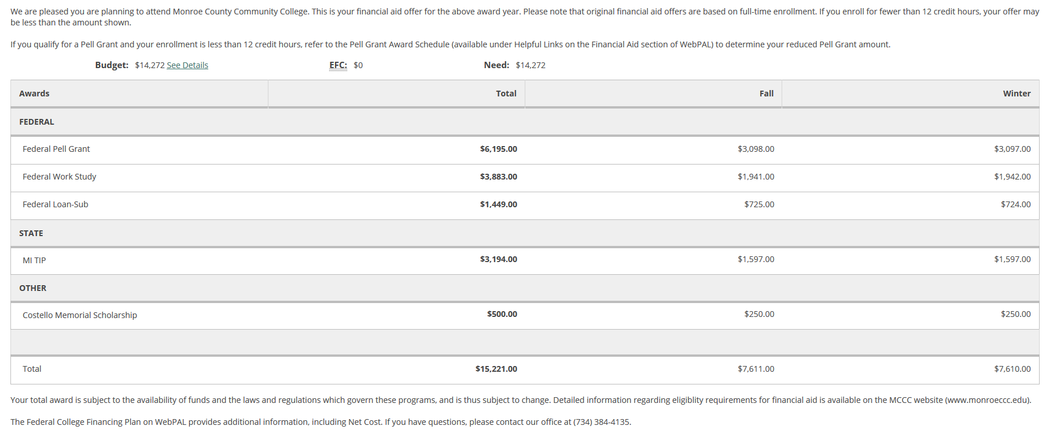
Financial aid Offer - Example
Gift Aid
Self-Help Aid
Self-Help Aid (Debt)
Gift Aid
Gift Aid

Slide 19

Financial Aid Offer
Q: Can a student receive a total financial aid offer that is more than the cost of tuition/fees and room/board?
  A: Yes - Some students will have educational expenses above and beyond tuition/fees and room/board that they might need money to cover.
    Books & Supplies
    Transportation
    Computer

Slide 20
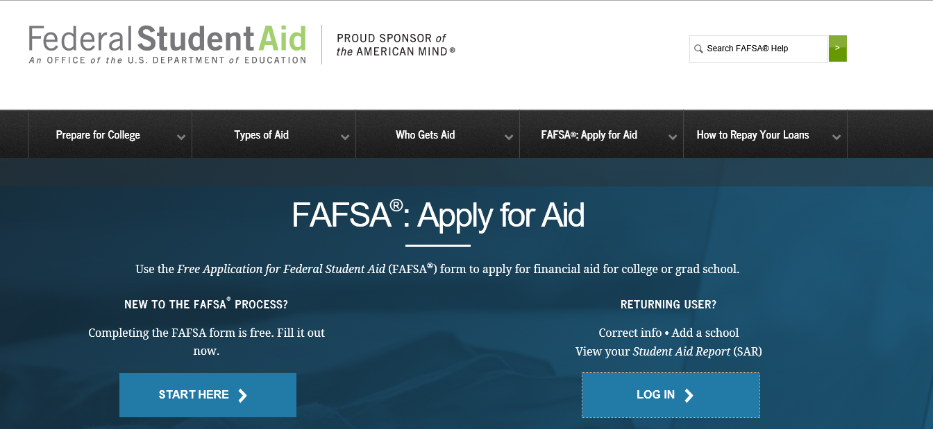
Filing the FAFSA
The student will file the 2021-2022 FAFSA, to apply for federal financial aid for the Fall 2021 semester.
Students may file the FAFSA as early as October 1st 2020.
Complete the FAFSA online at www.FAFSA.gov.
Students must file the FAFSA every year!

Slide 21
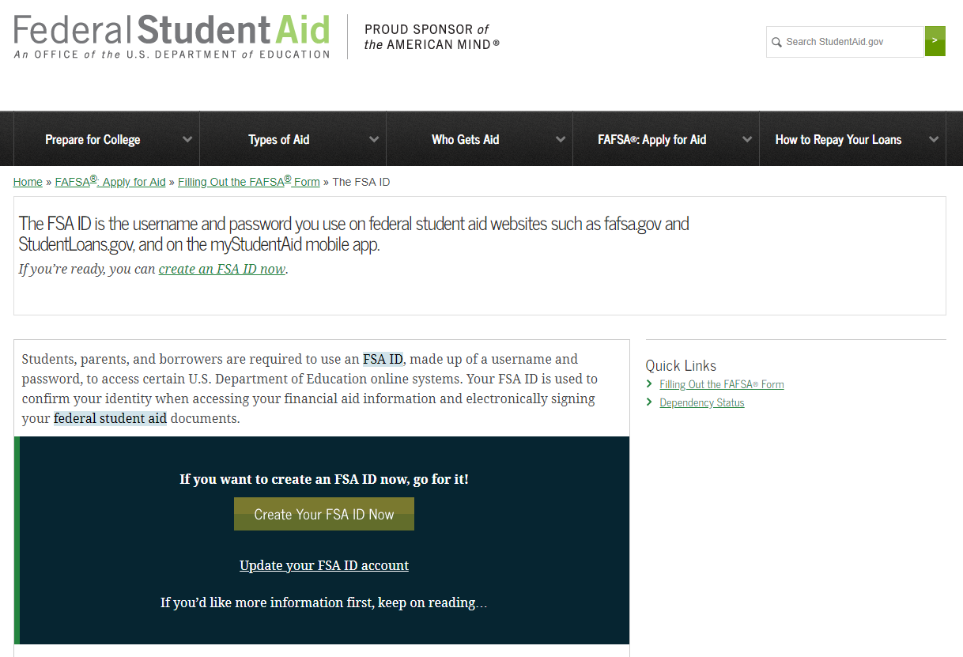
FILING the FAFSA – Apply for a Federal Student Aid (FSA) User ID
The student and the parent will each apply for a FSA User ID.
The FSA User ID will be used each year to electronically sign the FAFSA.
The FSA User ID allows the student to access his / her FAFSA and import tax information from the IRS for the income section of the FAFSA.
*Please note: the student and parent should not use the same email when applying for a FSA User ID

Slide 22

Filing the FAFSA - Things to note
Complete the FAFSA early!
  Schools have different priority filing deadlines for the FAFSA.
  Institutional financial aid is limited.
    Students who file the FAFSA early have a better chance of qualifying for institutional grants and scholarships.
Information students and parents will need to complete the 2021-2022 FAFSA:
  Student's 2019 income information (from W2s and federal tax return)
  Parent(s)' 2019 income information (from W2s and federal tax return)
    This is prior-prior year income.

Slide 23
Filing the FAFSA- parent information
Dependent students are required to report parent information on the FAFSA. For reporting purposes, “parent” means your legal (biological or adoptive) parent or stepparent, or a person that the state has determined to be your legal parent.
  If your parents are married to each other, then report information for both parents on the FAFSA
  If you parents live together, then report information for both parents on the FAFSA, even if they were never married, are divorced, or are separated.
  If your parents are not married and do not live together, you will use which ever parent you lived with more than the other over the past 12 months. Also, if this parent remarried, you will need to report information for your stepparent on the FAFSA.
  If your parents are not married and do not live together and you live with both equally, then report information on the FAFSA for the parent who provided more financial support over the past 12 months. Also, if this parent remarried, you will need to report information for your stepparent on the FAFSA.
  https://studentaid.ed.gov/sa/fafsa/filling-out/parent-info#who-is-parent

Slide 24

Filing the FAFSA – IRS Data Match
There is a feature on the 2021-2022 FAFSA that allows students and parents to import their tax information onto the FAFSA directly from the IRS database.
  The Department of Education strongly encourages the use of this feature for accuracy in reporting income information.
Most people who filed a 2019 tax return should be able to import their tax information onto the FAFSA
  If you are married and filed your tax return as Married Filing Separately or if you filed a Puerto Rican or foreign tax return you are not eligible to use the IRS Data Retrieval Tool
If you are ineligible or otherwise choose not to use the IRS Data Retrieval Tool to retrieve tax information, your college may require a copy of your IRS Tax Return (or your parents’ IRS Tax Return, if you are a dependent student).

Slide 25
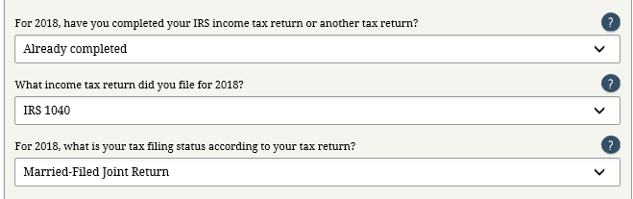



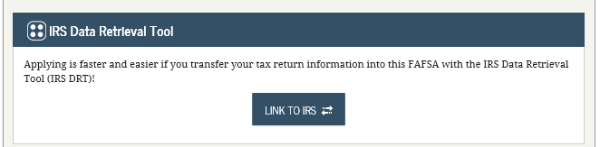
IRS Data Retrieval Tool
2019
2019 income information

Slide 26
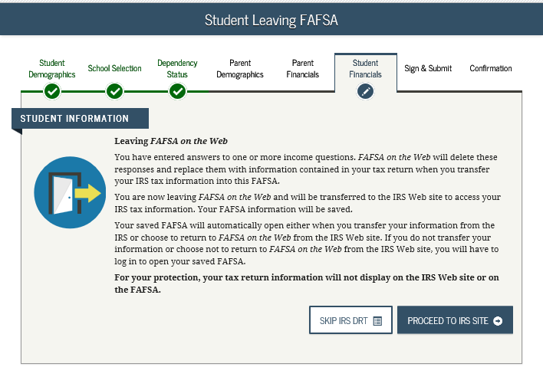
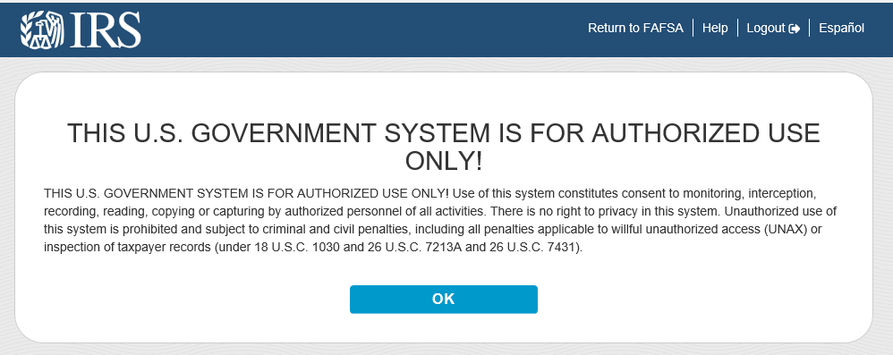
IRS Data Retrieval Tool
The “Link to IRS” button will take you to this page.
You will leave FAFSA on the Web and will be transferred to the IRS website to access your IRS tax information.

Slide 27
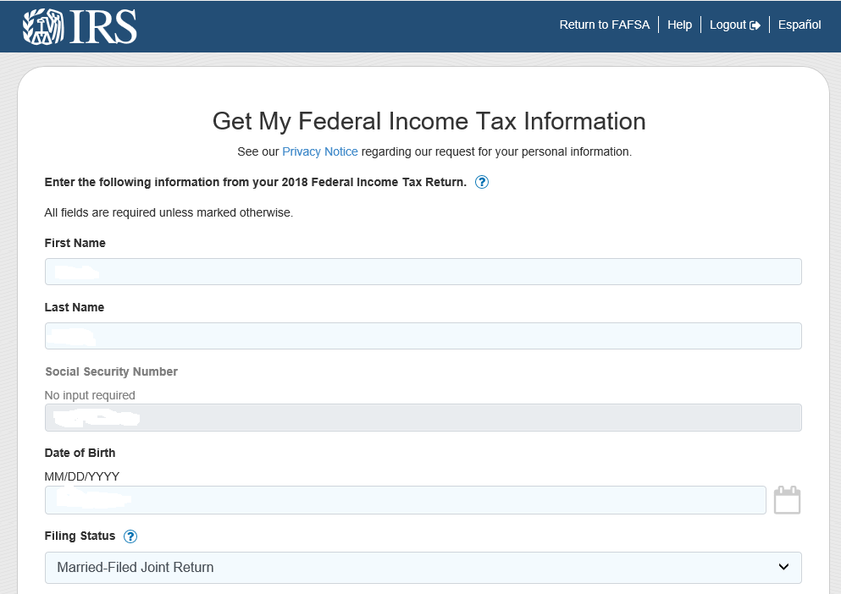
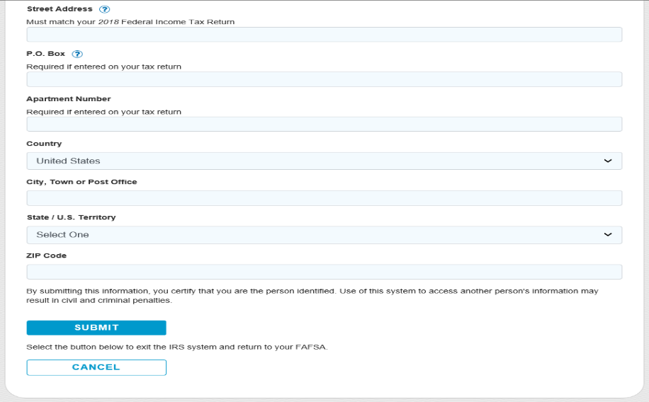
IRS Data Retrieval Tool
You will enter the IRS.gov Website.
You will need to enter in your address exactly how it looks on your 2019 Federal Income Tax Return.
Then click Submit.

Slide 28
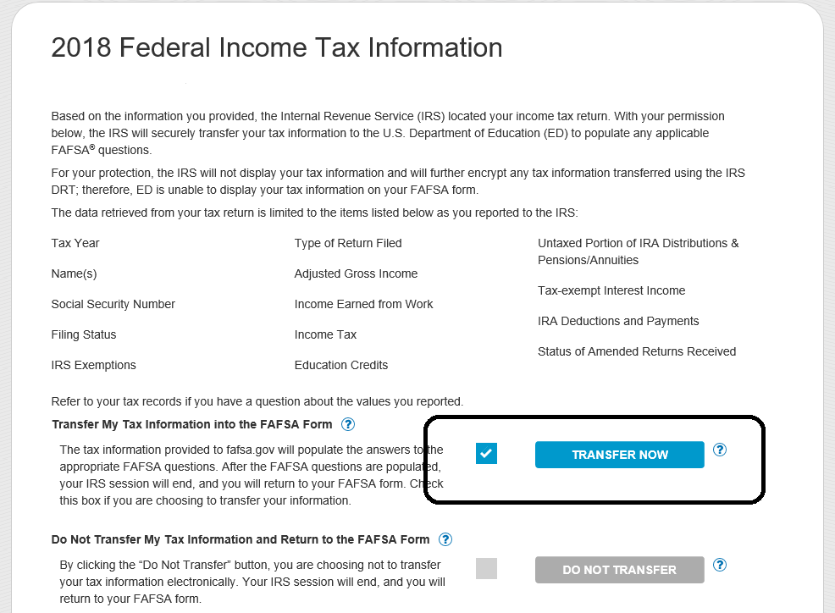
IRS Data Retrieval Tool
You will be provided a list of all the possible fields from a tax return that could transfer back into the FAFSA form.
Your tax information will be masked for your security.
Check the box “Transfer My Tax Information into the FAFSA”
Then Click the
“Transfer Now” button.

Slide 29
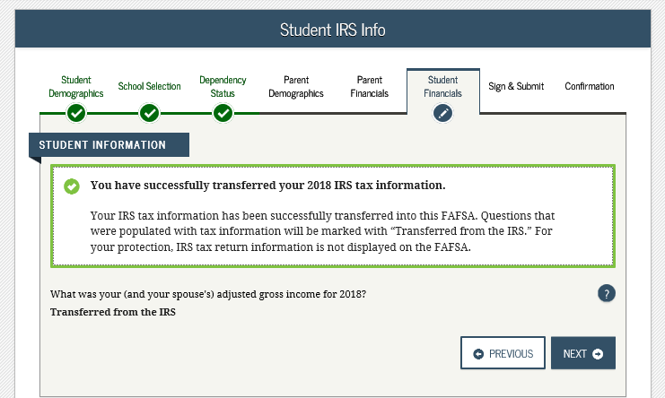
IRS Data Retrieval Tool
The site will take you back to the FAFSA and give you confirmation that you have successfully transferred your 2019 IRS tax information.
You will not be able to view the transferred income and tax information on the FAFSA.
You will see the words “Transferred from the IRS in the data entry fields throughout the online FAFSA.

Slide 30

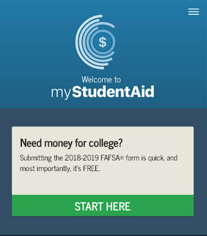
FILING THE FAFSA- myStudentAid App
mySudentAid is the official app of Federal Student Aid (FSA) and the U.S Department of Education where you can submit your FAFSA

Slide 31
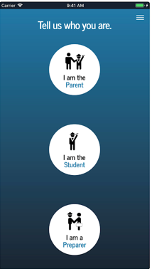
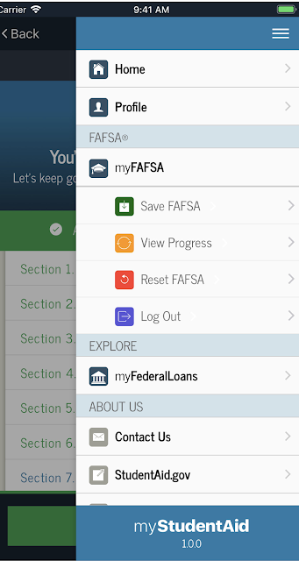
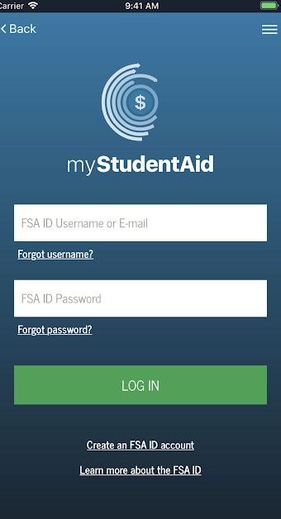
Log in with your FAFSA ID
You can submit a 2021-2021
FAFSA with this app
myFAFSA: save, view
progress, reset options
Explore myFederalloans

Slide 32
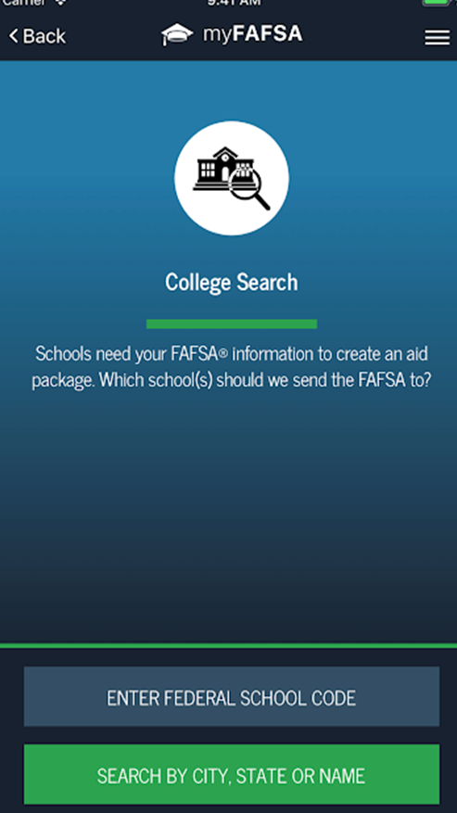
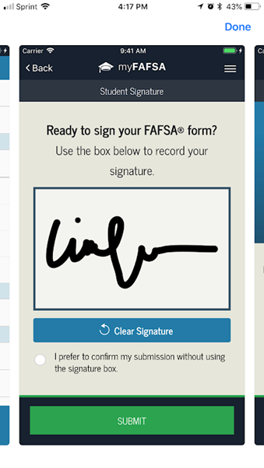
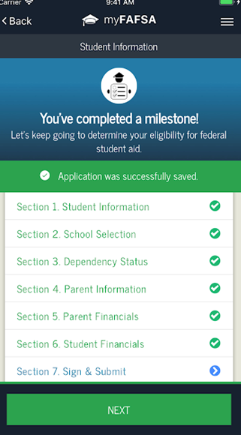
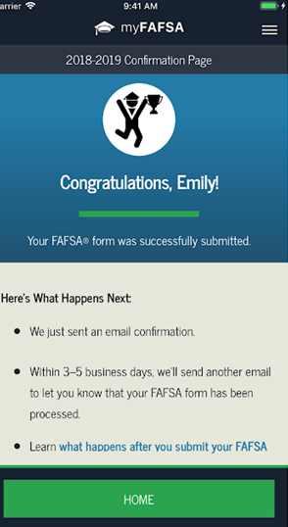
A check list
shows you when
you've completed
each step
Download
the App now!
Simply add
a school code
Easy signature
box

Slide 33

Final Notes
Many schools issue students a school e-mail address upon acceptance, and e-mail is a primary form of communication with the student.
  Students need to check their school e-mail accounts regularly!
Students may receive requests from the school's Financial Aid Office for additional documents.
  Submit any documents requested right away!
  Schools will request these documents because they need them to finalize a student's financial aid offer.

Slide 34

Final Notes
Schools have to comply with the Family Educational Rights and Privacy Act (FERPA) for disclosing information about a student's file.
  Per FERPA, detailed information about a student's financial aid account can only be discussed with the student!
Some schools will allow a student to sign a FERPA release.
  Purpose is for the student to give representatives of the school permission to discuss the student's academic record with specific people.
The staff in the financial aid office cannot give details to parents about your child's account unless your child is with you, or there is a signed FERPA release on file.
  Check with the school to find out if the school allows students to complete a FERPA release.

Slide 35

Questions?

