Slide 1
Ida Early Middle College
& Dual Enrollment
Ida High School
April 3, 2024

Slide 2
WHAT IS DUAL ENROLLMENT & IDA EARLY MIDDLE COLLEGE (IEMC)?
Dual Enrollment and Ida Early Middle College allows college-ready students in high school, who qualify for college admission to earn college credit prior to graduation.

Slide 3
DUAL ENROLLMENT & IDA EARLY MIDDLE COLLEGE IS NOT . . .
Dual Enrollment/Ida Early Middle College is not a replacement for high school.
First and foremost you are a high school student and a teenager and your course selection should reflect your personal ability and your college and career goals.
Ida High School offers a quality education and students are encouraged to take advantage of everything Ida has to offer.

Slide 4
GRADUATION REQUIREMENTS
Students participating in the dual enrollment and Ida Early Middle College program must still meet ALL state and district requirements for graduation with regard to credits earned and testing.
Dual enrollment courses count as elective high school credit unless otherwise discussed.
Students may take a maximum of 10 dual enrollment courses.
Students can take no more than 6 dual enrollment courses in any academic year.
Students’ grades from college classes can impact both their high school and college GPA.

Slide 5
DUAL ENROLLMENT COURSES
Students can take any course available from Monroe County Community College so long as it is not offered at IHS and applies toward either a degree or professional certificate or meets general requirements of the community college.
Courses that are a hobby, craft, recreational or a course that is in the areas of physical education, theology, divinity, or religious education, are not eligible for tuition support.

Slide 6
PLANNING AHEAD
Students should begin planning what they will do after they graduate from IHS or IEMC
Many students will work toward a degree or program at MCCC or take classes that they plan to transfer to another college or university.
COURSE PLANS at MCCC: https://www.monroeccc.edu/pathways
MCCC Transfer info https://www.monroeccc.edu/transfer
Research which courses transfer https://www.transferology.com/chooseyourpath.htm
Michigan Transfer Network https://www.mitransfer.org/
Michigan Transfer Agreement https://www.monroeccc.edu/transfer/michigan-transfer-agreement

Slide 7
MICHIGAN TRANSFER AGREEMENT
+

Slide 8
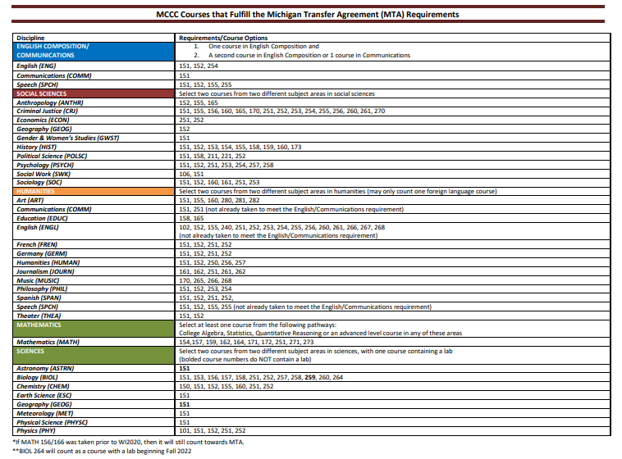
MCCC Michigan Transfer Agreement Courses
+

Slide 9
MCCC Update for Fall 2024
Traditional Classes-in person classes usually meeting twice a week
Online classes-all work is done online
Blended class-specific set aside time, time is in person or online, depends on professor
Please review MCCC for further information:
https://www.monroeccc.edu/online-and-blended-classes
Please consider the following:
Highly recommend taking in person classes but there are some exceptions
Student’s academic skills
Student’s responsibility and maturity

Slide 10
ADDITIONAL COLLEGE EXPENSES
Course Materials (Textbooks & Online Codes)
Some college textbooks are available to borrow in the Ida High School library.
Textbooks may be reimbursed by Ida High School if the State amount has not been exhausted. Students will need to hand in their textbook and original receipt with the textbook request form. Forms are due two weeks after the MCCC semester ends.
Reimbursement amounts will be calculated by taking the amount of money received from State Aid and subtracting tuition and fee costs for each course.
Transportation
Ida High School is not responsible for providing transportation of students. Students must be able to transport themselves to and from the community college in order to participate in dual enrollment/IEMC.
Notes:
Mention different types of textbooks (traditional/ebooks/loose leaf) Buy New or Used or Rent (Many in our library)
Online codes-if possible we will reimburse for all forms including online cores
Check comes well after the semester

Slide 11
SCHOOL CALENDAR
Dual enrollment courses will follow the community college calendar as far as start/end dates for their semester and breaks (i.e. Spring Break).
The high school schedule always takes precedence over that of the community college. If a student’s attendance is required at the high school, they are expected to make arrangements with their college instructors (i.e. semester exam schedules).
Students may not sign up for dual enrollment courses whose meeting time will cause a student to be late or need to leave early from a high school class.
School cancellations or delays do not apply to college courses taken on the college campus. Students will still be expected to go to class unless the college also cancels. They too have an automated system to sign up for in case of cancellations.

Slide 12
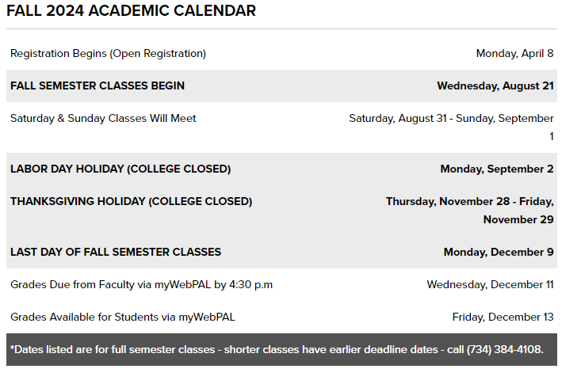
Notes:
Not updated for Fall, but student will receive one
Withdrawal and Drop Datel

Slide 13
STUDENT SUPPORT SERVICES
As a dual enrollment/IEMC participant, students are considered to be college students and thus have access to all the services and supports afforded to all full-time enrolled students at the community college.
Services may include …
Academic Tutoring (Study Skills, Writing & Math Labs)
Campus Libraries
Computer Labs
Career Services
Counseling Services
Transfer Coordinators
Athletic/Fitness Facilities
Students must use their community college instructors and support services.
Tutoring/Learning Assistance | Monroe County Community College (monroeccc.edu)

Slide 14
FAILURE OR NON-COMPLETION OF COURSES
Students who fail or do not complete a dual enrollment course (i.e. drop the course after the drop deadline of the community college) will be held financially responsible for the full cost of the course.
These costs must be settled with the district in order for a student to participate in graduation ceremonies and receive their diploma.
Students who fail courses may jeopardize their continued participation in the dual enrollment program.
Failing dual enrollment courses will negatively impact a student’s standing at their post-secondary schools after graduation.

Slide 15
College Class Eligibility
–Student must be on track for high school graduation
–Student must have a 2.5 GPA, earned B or better in English 9 S2 & English 10 S1, AND C or better in Algebra 1
IF not, student needs to take the Accuplacer on 4/24 during 1st-3rd hours
–Must apply to MCCC
-Must meet all Ida requirements and deadlines to participate
Notes:
2.5 GPA a few exceptions Automotive, welding, ect
Accuplacer-Lunch meeting today to review their scores (if they need to retake than they can do so at the college testing center)

Slide 16
IS DUAL ENROLLMENT/IDA EARLY MIDDLE COLLEGE RIGHT FOR ME?
Things to Consider
Future plans
Study Habits
Reading & Writing Abilities
Time Management Skills
Ability to Ask Questions & Seek Help
Social/Emotional Maturity
Ability to Work with Different People
Involvement Level in High School (Extracurricular Activities)
Notes:
Average age of MCCC Student is 23
Time Management -Credit college class 2 hour of studying outside of class. One 3 credit class Mon/Wed 8:00-9:20 6 hours a week additionally studying for that class
Social/Emotional Maturity-

Slide 17
Pros & Cons for Consideration
Pros
Cons
Reduce the cost of a post-secondary education
Reduced time needed to complete a degree or certificate
Expanded opportunity to take courses not offered at Ida
Experience college level work prior to graduation
Receive both high school and college credit More likely to complete college degree
Participation impacts time to be involved in Ida activities and with friends
Travel time and costs (i.e. bad weather, cost of gas)
Difference in social maturity between high school and college/adult students
Parents do not have a right to student information (FERPA belongs to student)
Failures and withdrawals can impact high school / college GPA and have additional financial costs
Dual enrollment grades can impact a student’s standing at the high school and future colleges
Notes:
If a student completed two college classes, they are more likely to finish the degree -Supports!!!

Slide 18
Registration Checklist
Consider your future goals and make sure this is a fit.
Make sure your student meets previously mentioned academic requirements.
Apply to MCCC by April 5th!
Complete Google Interest Form by April 5th
Friday, April 29th Student Lunch Meeting
Sign-up for a 20 minute MCCC Course Selection meeting May 1st-May 10th
Sign up will through Dr. Daniels’ Bookings Page at the lunch meeting
During this meeting: register for classes, checklist, orientation, books, and so on.
Complete Fall Registration and contract forms during your conference with Dr. Daniels
Student and parent must sign registration and contract form.
Turn in Registration Form to MCCC Rep via email by May 13th.
CC parent & counselor in email
If applicable, complete IEMC Application and turn into Dr. Daniels by May 17th .

Slide 19
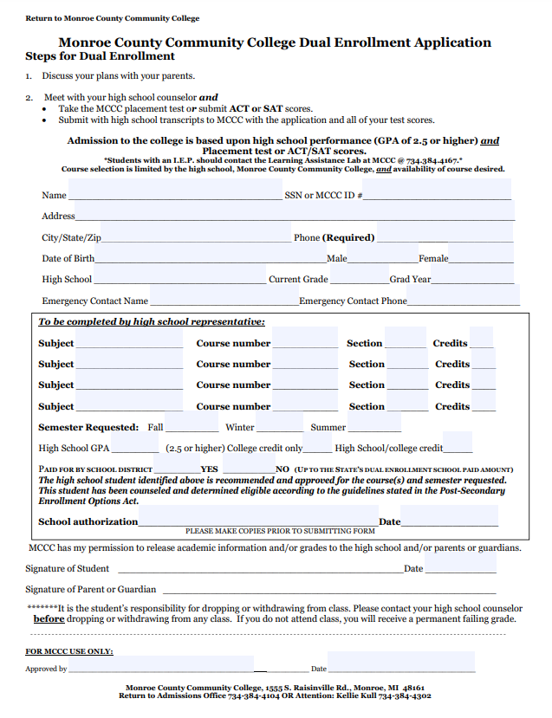
Dual Enrollment forms must be turned into a MCCC Representative via email by May 13th.
First week of school:
Mandatory Fall Meeting for all
Dual Enrollment and Ida Early Middle College Students
Notes:
talk about gpa on both transcripts?

Slide 20
HIGH
IDA
SCHOOL
PRESENTS...

Slide 21
BASIC INFO
Similar to Dual Enrollment junior and senior year.
Ida Early Middle College gives students the opportunity to earn an extra year of college credits (up to 60 credits total).
Student participates with current class in all aspects of their senior year.
IEMC students participate in graduation with their class, but do not get their diploma or officially graduate until the completion of their 5th year.
Students will be ranked with their class.
Students can participate in high school programs and sports through their 4th year.
Students can wait until the 4th or 5th year to take college classes.
In addition there will be a math course needed for their 5th year.

Slide 22
BASIC INFO
At the end of the 5th year the student will have opportunity to earn all of the following:
High School Diploma
MEMCA Certificate
Up to an Associate's degree

Slide 23
IEMC STUDENT SUPPORT AND TRANSFER
Student Support
Students have access to high school and
MCCC support services
Regular contact with high school counselor
3rd-4th year IEMC seminars
5th year mandatory conference with college advisor
IEMC 5th year seminars once a month
Transfer Options
Research transfer college/university
Students are considered 1st year students
Customizable Education Options
Flexibility with MCCC classes
The state requires that students apply for middle colleges by the student’s Sophomore year, but they can withdraw from IEMC

Slide 24
APPLICATION PROCESS
Discuss with your family if IEMC is the correct program for you.
If planning to take classes junior year, complete all previously mentioned dual enrollment requirements.
Complete IEMC application and turn it into Dr. Daniels by May 17th
Participate in IEMC interview in late August/Early September

Slide 25
IEMC Graduating Class 2017-2023
Total Number of Students: 59
Total Credits Earned: 2,563
29 Transferred & 21 Cont at MCCC
6 Associate’s Degrees
6 Certifications
Money Saved over: $371,631
Scholarships offered over: $306,50040
 | MEMCA | IEMC
-Average Credits Earned | 49.5 | 45
-Average GPA | 2.93 | 3.12

Slide 26
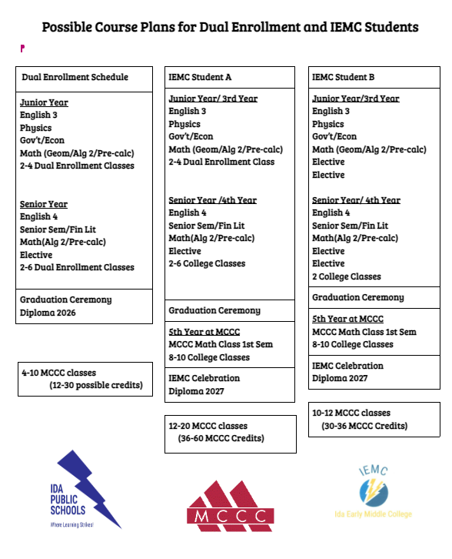
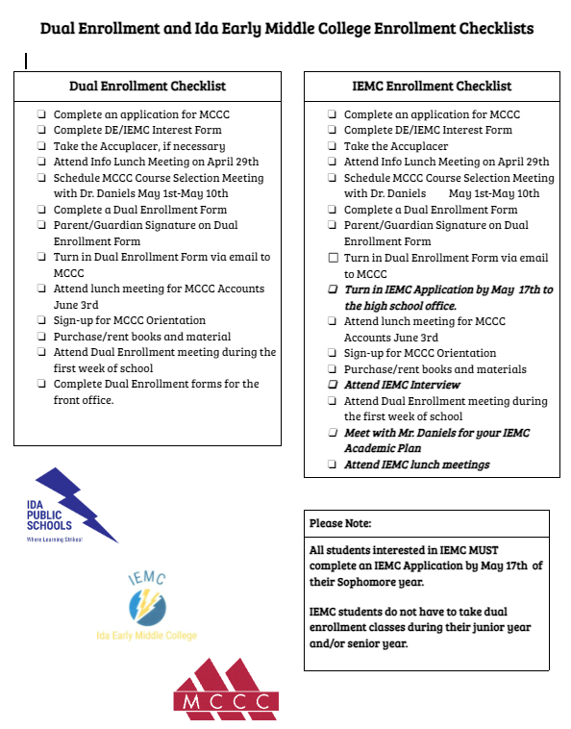

Slide 27
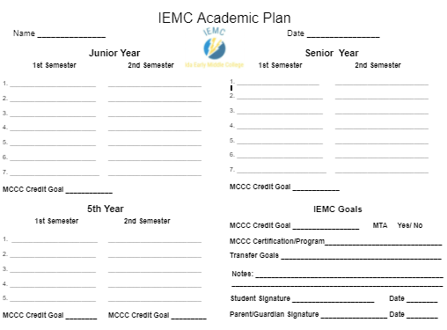
Individual Academic Plan for Each IEMC Student

Slide 28
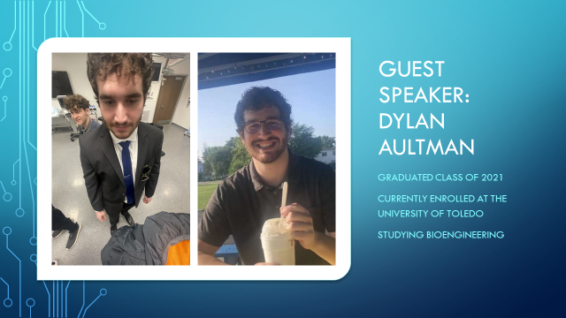

Slide 33
Student Experience & Advice From IEMC Students
When asked “Do you feel like you achieved your goals through IEMC?”
“Yes!”
“For sure, I started the RN program this winter( winter of 2020) so I’d say I did pretty good”
“Yes, I had no idea what mechanical design engineering was, and fell in love with the program. I also have already had interviews with a local company who I will be starting with after receiving my college degree.”
“IEMC helped me make sure I was choosing classes that were right for me, so I feel like that helped me take on the classes with more confidence knowing that I was actually going to need them for the degree I was pursuing. “
When asked “Are you glad you decided to be apart of the IEMC program? Why or why not?”
“Yes because it gave me a full year of college and kept me from deciding not to go to college, it motivated me.”
“Yes! Got me to push myself & achieve/figure out what I want to do”
“Yes, I was able to get almost 60 credits for free! “
“100% glad I decided to come into this program, it has given me many opportunities that at may have not been possible before”
Yes, I had a huge head start on college and feel proud of what I’ve accomplished.

Slide 34
Questions???
ryan@idaschools.org
daniels@idaschools.org

